Slide 1

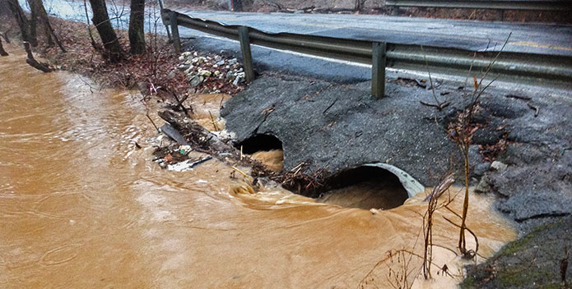
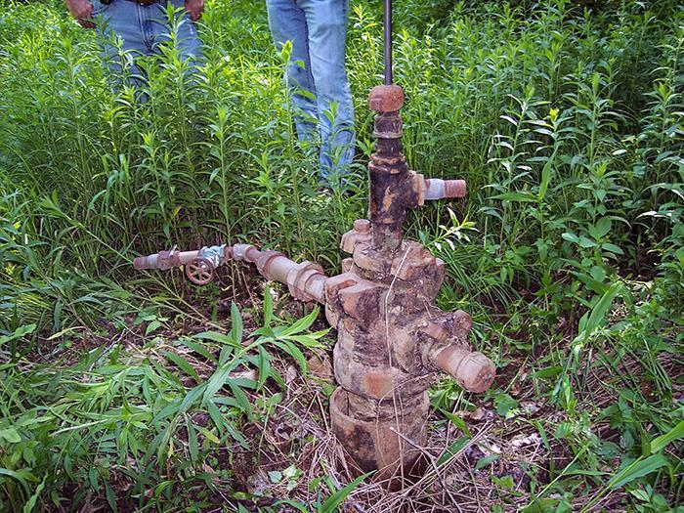
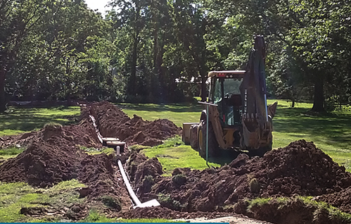
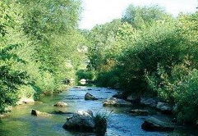
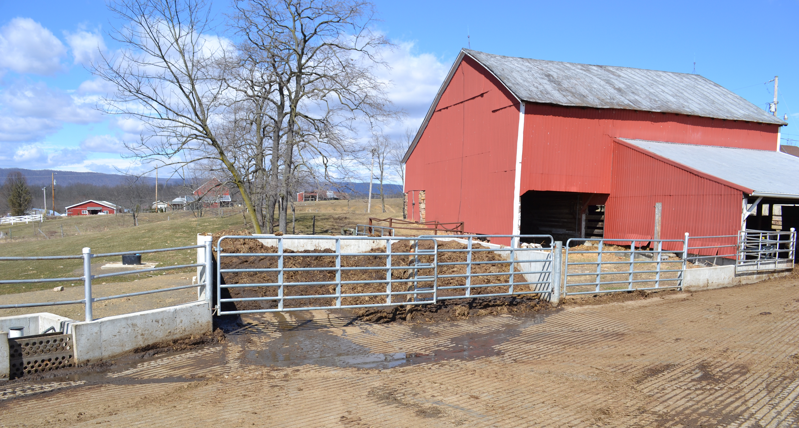

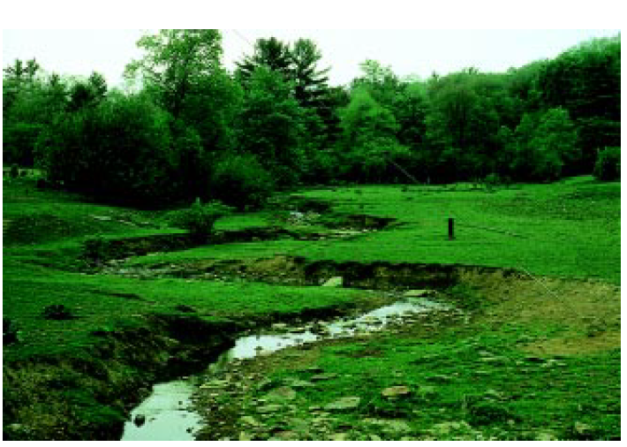
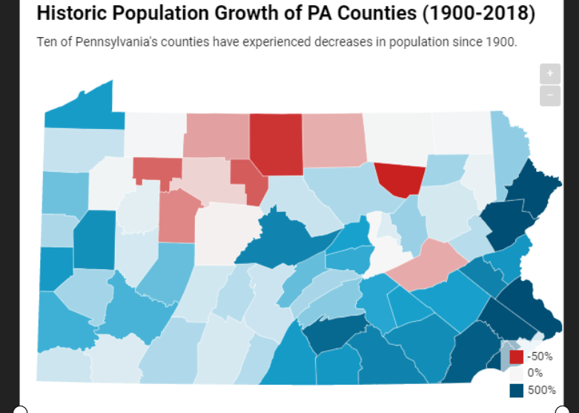
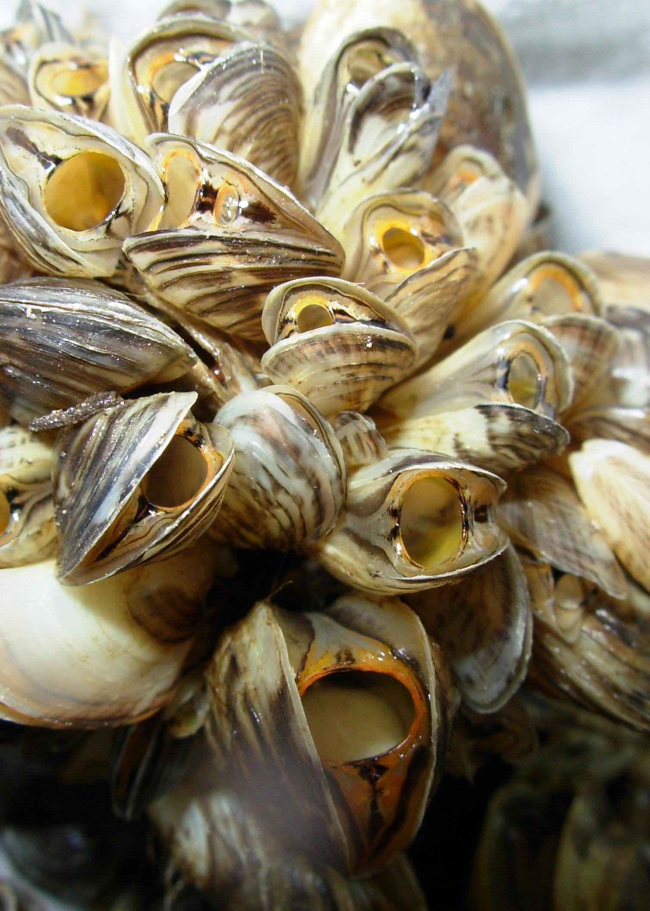
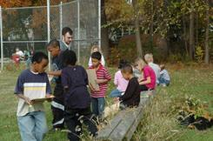
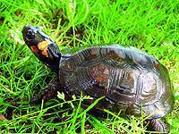
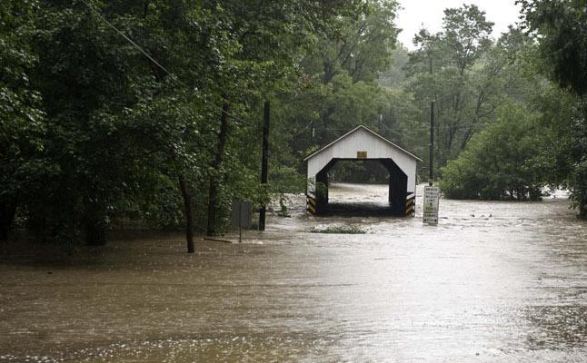
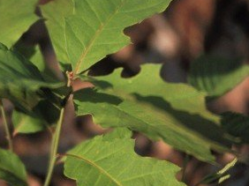
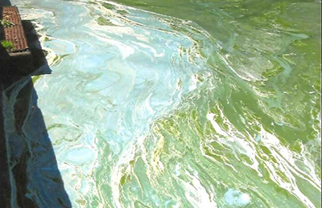
Watershed Ecosystem
Biosphere
Recreation
Cultural Systems
Aesthetic
Societal
Economic
Ethical
Climate Systems
Atmosphere
Government
Economic Systems
Political
Religious
Educational
Environmental Justice
Personal
Natural Resource Management
Geosphere
Hydrosphere
Ethnocentric
Ecological
Health
Safe Drinking Water
Recreational
Urban Stormwater Runoff
Scientific
Environmental
Wastewater
Energy Industry
Agricultural Impacts
Emerging Contaminants
Stream Impairment
Riparian Buffers
Population Growth & Development
Climate Change
Invasive Species
Forestry
Wildlife Threats
Harmful Algal Blooms
Environmental Justice
Notes:
Green = Natural Systems
Blue = Human Systems
Orange = Value Descriptors

Slide 2
Watershed Ecosystem
Biosphere
Recreation
Cultural Systems
Aesthetic
Societal
Economic
Ethical
Climate Systems
Atmosphere
Government
Economic Systems
Political
Religious
Educational
Environmental Justice
Personal
Natural Resource Management
Geosphere
Hydrosphere
Ethnocentric
Ecological
Health
Safe Drinking Water
Recreational
Urban Stormwater Runoff
Scientific
Environmental
Wastewater
Energy Industry
Agricultural Impacts
Emerging Contaminants
Stream Impairment
Riparian Buffers
Population Growth & Development
Climate Change
Invasive Species
Forestry
Wildlife Threats
Harmful Algal Blooms
Environmental Justice
Notes:
Green = Natural Systems
Blue = Human Systems
Orange = Value Descriptors

Slide 3
Watershed Ecosystem
Biosphere
Recreation
Cultural Systems
Aesthetic
Societal
Economic
Ethical
Climate Systems
Atmosphere
Government
Economic Systems
Political
Religious
Educational
Environmental Justice
Personal
Natural Resource Management
Geosphere
Hydrosphere
Ethnocentric
Ecological
Health
Safe Drinking Water
Recreational
Urban Stormwater Runoff
Scientific
Environmental
Wastewater
Energy Industry
Agricultural Impacts
Emerging Contaminants
Stream Impairment
Riparian Buffers
Population Growth & Development
Climate Change
Invasive Species
Forestry
Wildlife Threats
Harmful Algal Blooms
Environmental Justice
Notes:
Green = Natural Systems
Blue = Human Systems
Orange = Value Descriptors

