Slide 1
Informed Action

Slide 2
Activity 1
Claim Evidence Reasoning

Slide 3


Connecting Issue Investigation to Action
CLAIM: A statement of a student’s understanding about a phenomenon or about the results of an investigation.
EVIDENCE: Scientific data used to support the claim.
REASONING: Ties together the claim and the evidence.
Claim, Evidence, Reasoning student worksheet

Slide 4

Has anyone used CER with students?
What other approaches have you used to develop evidence-based claims?

Slide 5
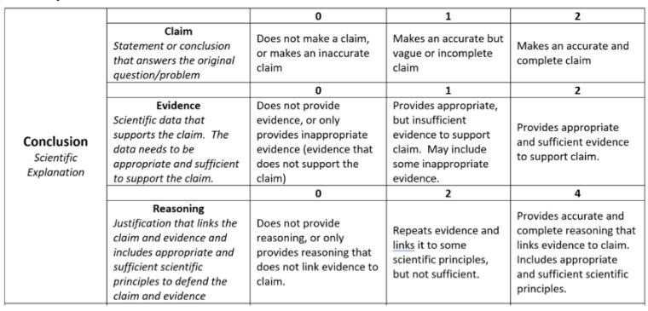
Assessment - CER Rubric
Source: https://www.chemedx.org/article/implementing-claim-evidence-reasoning-framework-chemistry-classroom

Slide 6
What do you think of this rubric? Would you make changes?
How have others assessed CER work?

Slide 7
Activity 2
Bolstering Youth Voice in Action

Slide 8
Divergent / Convergent Thinking
Divergent Process
(Solo-Storming)
Group Storming (every idea counts!)
Convergent Process (planning & designing)

Slide 9

Environmental Phenomenon
[Insert a CER statement from Activity 1]
Types of Environmental Action Projects
Page 10

Slide 10
How was your experience of first thinking of projects on your own?
How did your ideas compare to others?
Do you think this method would work with your students?

Slide 11
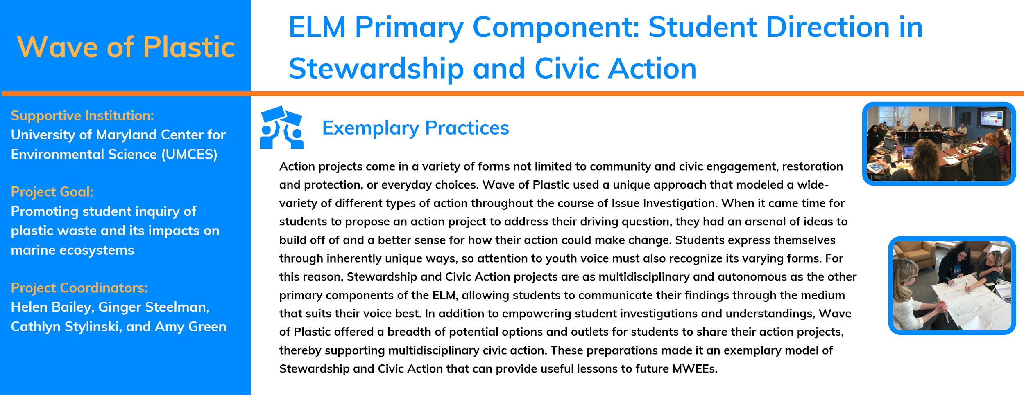
Modeling Action throughout the MWEE

Slide 12
LESSON 1
Explore the prevalence of plastics and plastic waste in everyday life. Investigate issues about per-capita consumption and disposal of plastic and consider alternative choices.
LESSON 2
Understand plastics as synthetic materials and explore the properties of plastic that have positive and negative impacts on the environment and society.
LESSON 3
Investigate the properties of plastic that allow it to move into waterways. Engage in outdoor field investigations to determine how runoff will move across surfaces and collect data about plastic pollution found in their local communities.
LESSON 4
Investigate how plastic pollution disrupts elements of an ecosystem and/or affects organisms.
LESSON 5
Reflect on the first 4 lessons. What are the big issues? What actions have we engaged in? What is a collective action that our class engage in that will make a measurable difference in this issue?
MODELED ACTION
Engage communities with public service announcements.
MODELED ACTION
Design/administer a plastic use survey for the school
MODELED ACTION
Create an infographic to educate the public on plastic issues
MODELED ACTION
Participate in a personal or class pledge
STUDENT LED ACTION!

Slide 13
Modeling action is completely optional…
What are the opportunities or challenges around employing this method?

Slide 14
Moving from Claims to Informed Action
Complete the Moving from Claims to Informed Action student worksheet with the claim you developed in your CER

Slide 15
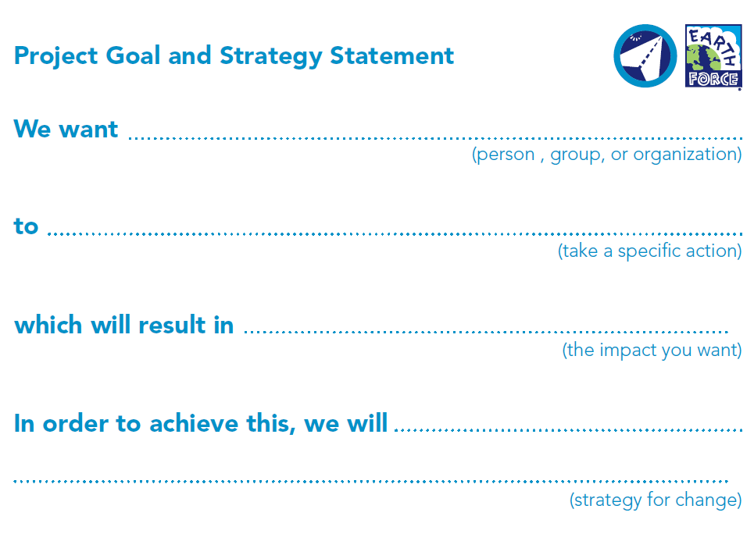
Choose one of the three action projects (solutions) you brainstormed to complete this strategy statement with.

Slide 16
Which method will you use to support youth voice during action project brainstorming?

Slide 17
Activity 3
Choosing an Action Project

Slide 18
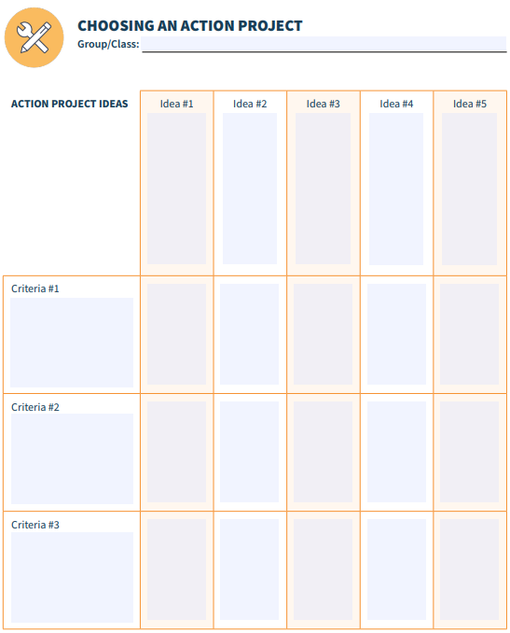
Deciding on an Action

Slide 19
When determining criteria for Action project selection...
Realistic - will students be able to carry out the strategy given the available resources?
Precedent - how have others used this strategy before, and how well did it work?
Relevance - how much does the strategy actually address the project goal?
Simplicity - how easy or difficult will the strategy be to carry out?
Impact - how likely is it that the strategy will have a lasting impact? Will it be sustainable?
As the educator, you are aware of the limiting factors. What criteria would you need to list in the Choosing an Action Project worksheet?

Slide 20
How well do you think this activity will work for selecting an action project?
Have you used other methods?

Slide 21
Activity 4
Action Project Planning

Slide 22
Action Project Planning
Create a work plan for setting the action into motion
  Review the Environmental Action Planning student worksheets for ideas
Evaluate the action against the MWEE Audit Tool
Share how your group will engage all students in the planning and implementation of the action project
Page 45

Slide 23
Evaluating Action
How would you assess a student’s involvement in the action project?
How would you guide reflection of the action project and MWEE experience?

Slide 24

ShoreRivers + Dorchester & Talbot County 3rd Grade
Review the last page of the ELM - Informed Action
Take note how this section does not list out an action project but rather sketches out a plan for how the educator will guide action project selection, design and implementation.
Evaluate the action against the MWEE Audit Tool
Page 45

Slide 25

Activity 5
Plan it!

Slide 26
Planning your MWEE!
Complete the Informed Action section (page 26) of the Environmental Literacy Model (ELM)
Reference the MWEE Audit Tool (pages 37-54) for additional guidance
Use each other to bounce off ideas!

