Slide 1
Issue Investigation

Slide 2



SIDE NOTE - Workshop logistics
Throughout this workshop, to build understanding and confidence around MWEEs we will….
Provide time for participants to develop their own MWEE or fine-tune an existing MWEE
Model a shared
Workshop MWEE
Reference an Example MWEE from Conestoga Valley High School

Slide 3
Activity 1
Youth Voice

Slide 4

What does it mean to support youth voice?
What are you doing in your classroom or programs to support youth voice?
What are the biggest benefits for supporting youth voice? What are the biggest challenges in supporting youth voice?
Notes:
Virtual Breakout Option: https://www.baybackpack.com/files/Virtual_Student-Voice-Breakout_Discussion.pptx

Slide 5
Driving Question
Supporting Questions
[Workshop Driving Question here]
[Workshop Supporting Questions from Part 2 here]

Slide 6

How could you best support youth voice during the development of supporting questions?
Page 11

Slide 7
Activity 2
Modeling an Investigation

Slide 8
Driving Question
Supporting Questions
[Workshop Driving Question here]
[Workshop Supporting Questions from Part 2 here]

Slide 9
Considerations while Planning an Investigation (as the student)
DATA | COLLECTION | LOGISTICS
What data already exists? What prior knowledge must we learn? Where can we find this information? | What tools do we have? What is the study site like and what type of data can we collect there? How will we collect data? What are our procedures? What roles/jobs are required to collect the data? | How much time do we have at the site? How many students will be at the site? Are there safety concerns?

Slide 10
Before we go outside…
What do we need to consider to make this a safe, effective, and manageable experience?
Notes:
Ask the group to brainstorm things to consider. Classify them into categories: safety, class management and logistics
Recognize and give voice to comfort levels-from hope and fears
Manage your own expectations. It’s okay if things change direction - embrace the learning moment. (share 4th grade story)
Key Point, if you do not have experience or comfort with student learning outside, Partners are key, consider engaging them. We are sending you some tools to give you some experience with the process. You are not expected to be the expert!

Slide 11
Synthesis and Conclusion
Be prepared to report the following:
What supporting question did you focus on?
Briefly describe how your field work went.
What conclusions can be drawn based on the information and data you collected and synthesized?
Communicate (pictures/charts/graph) what your conclusions were and how they relate to the Driving Question and Local Issue.
What more do you need to know? Were there new questions that popped up? What additional research and/or data do you need now?
Notes:
Virtual Option (Slide 1): https://www.baybackpack.com/files/Virtual_3.2_Synthesis-and-Conclusion-Report-Out-of-Independent-Investigations.pptx

Slide 12
Design a graphic representation of the data collected and information learned
Notes:
Virtual Option (Slide 2): https://www.baybackpack.com/files/Virtual_3.2_Synthesis-and-Conclusion-Report-Out-of-Independent-Investigations.pptx

Slide 13
Outdoor Field Experiences
Successes/Challenges
Supporting individual or group work outside
Connecting to class work
Assessing student learning
What learning happens best outside?

Slide 14
Activity 3
Outdoor Field Experiences in Pennsylvania

Slide 15
Explore nearby Outdoor Field Experience locations
Find your Park findyourpark.com | PAEE EE Near ME https://www.paee.net/find-ee-near-me/ | Wiki Watershed tools HTTPS://WIKIWATERSHED.ORG/MODEL/
Page 17
Notes:
[Make additions/subtractions and sub out webpages based on the location of your workshop]
Another example https://www.paimapinvasives.org/
Local parks, Conservancies, land trusts, museums, botanical gardens, community gardens, playgrounds, parking lots

Slide 16
Activity 4
More than a one-hit Field Trip: Outdoor Field Experiences support the whole MWEE

Slide 17
Conestoga Valley - High School
How do outdoor field experiences help to answer or look more deeply at the driving question/supporting questions?
Which learning objectives or standards do the outdoor field experiences help to address?
How was each outdoor field experience contextualized to give it more meaning?
How do indoor lessons and components support the overall issue investigation?
How might the indoor components provide students the opportunity to translate existing knowledge to the investigation?
Notes:
Conestoga Valley Think Cloud
https://www.baybackpack.com/files/Documents/Conestoga-Valley-Think-Cloud.pdf
Conestoga Valley Questions and Planning Investigations
https://www.baybackpack.com/files/Documents/Conestoga-Valley-Questions-and-Planning-Investigations.pdf
Conestoga Valley Moving from Claims to Informed Action
https://www.baybackpack.com/files/Documents/Conestoga-Valley-Moving-from-Claims-to-Informed-Action.pdf
Conestoga Valley ELM
https://www.baybackpack.com/files/Documents/Conestoga-Valley-ELM.pdf
Conestoga Valley ELM Curriculum Anchor
https://www.baybackpack.com/files/Documents/Conestoga-Valley-ELM-Curriculum-Anchor.pdf
Conestoga Valley ELM Issue Investigation
https://www.baybackpack.com/files/Documents/Conestoga-Valley-ELM-Issue-Investigation.pdf
Conestoga Valley ELM Informed Action
https://www.baybackpack.com/files/Documents/Conestoga-Valley-ELM-Informed-Action.pdf

Slide 18
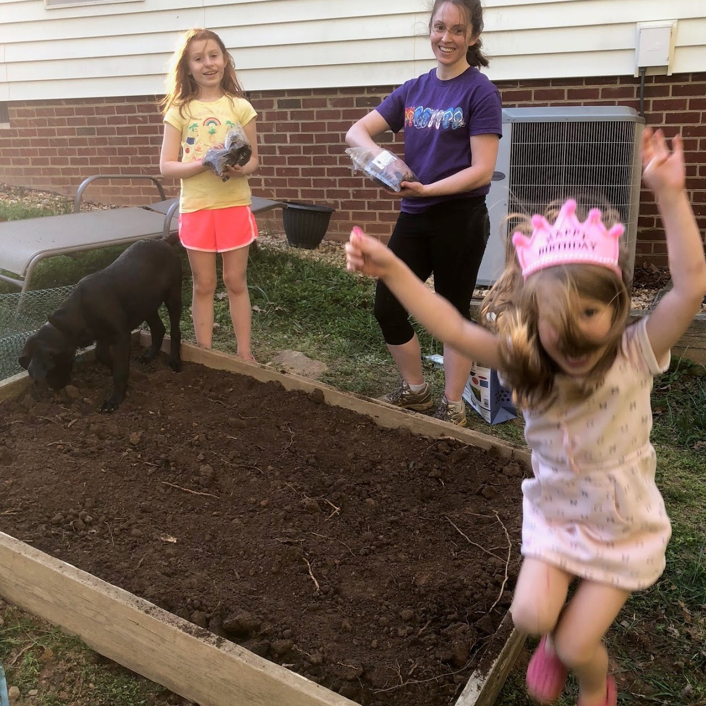
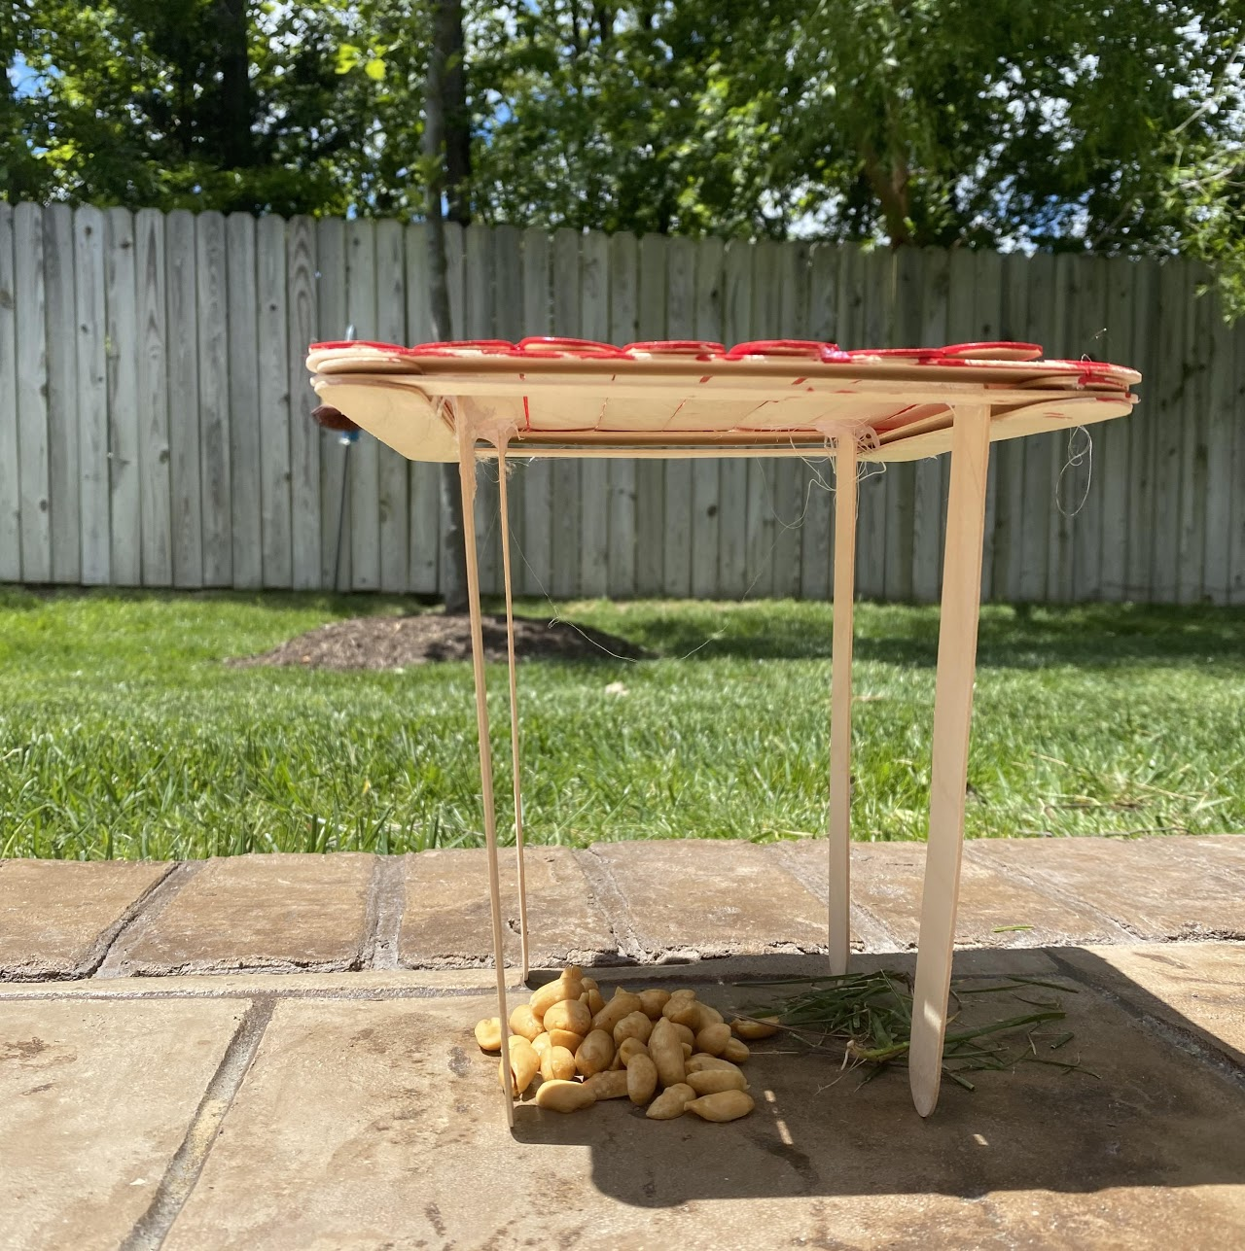
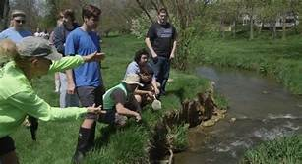
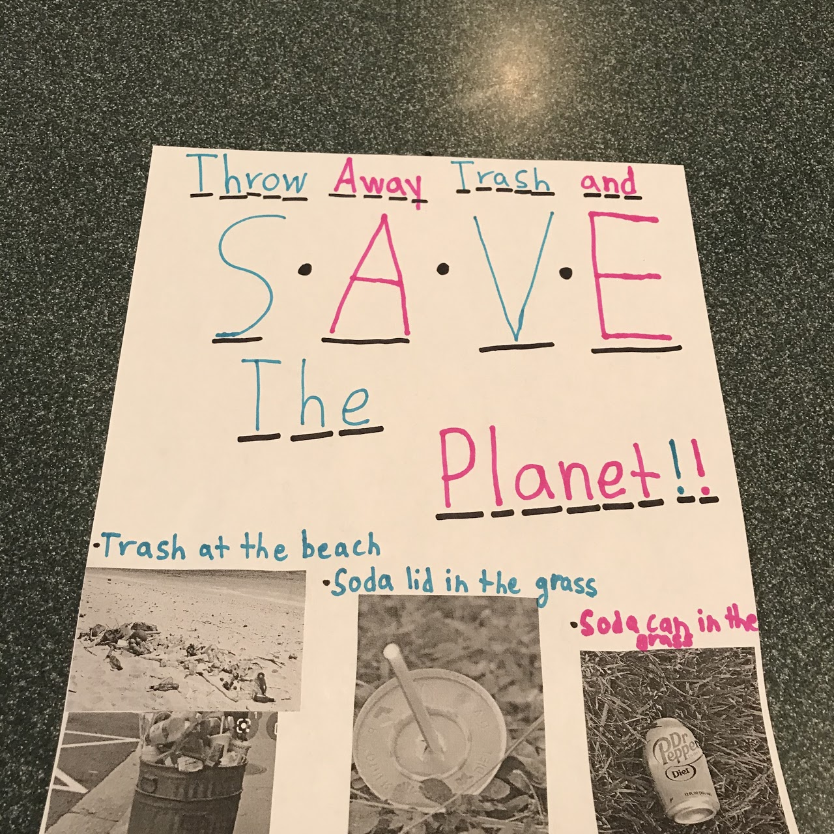
Inspiration and Inquiry Through Observation
High School/Middle School Examples:
Conestoga Valley
Elementary Level Examples:
Henrico Watershed Challenge
Notes:
Henrico: https://sites.google.com/henrico.k12.va.us/bwise/watershed-challenge
Used local observations at school and home in virtual mode
Students determined that habitat for pollinators was the

Slide 19
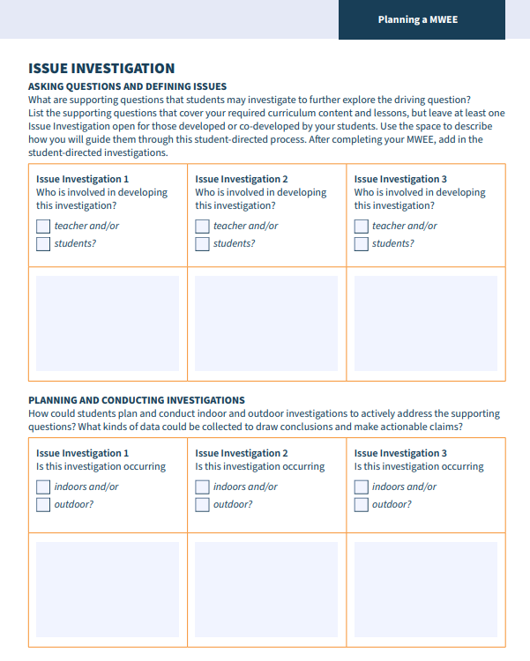
Activity 5
Plan it!

Slide 20
Planning your MWEE!
Complete the Incorporating Outdoor Field Experiences worksheet (pages 18-20)
Complete the Issue Investigation section (pages 24-25) of the Environmental Literacy Model (ELM)
Reference the MWEE Audit Tool (pages 37-54) for additional guidance
Use each other to bounce off ideas!

Slide 21
Additional Resources

Slide 22
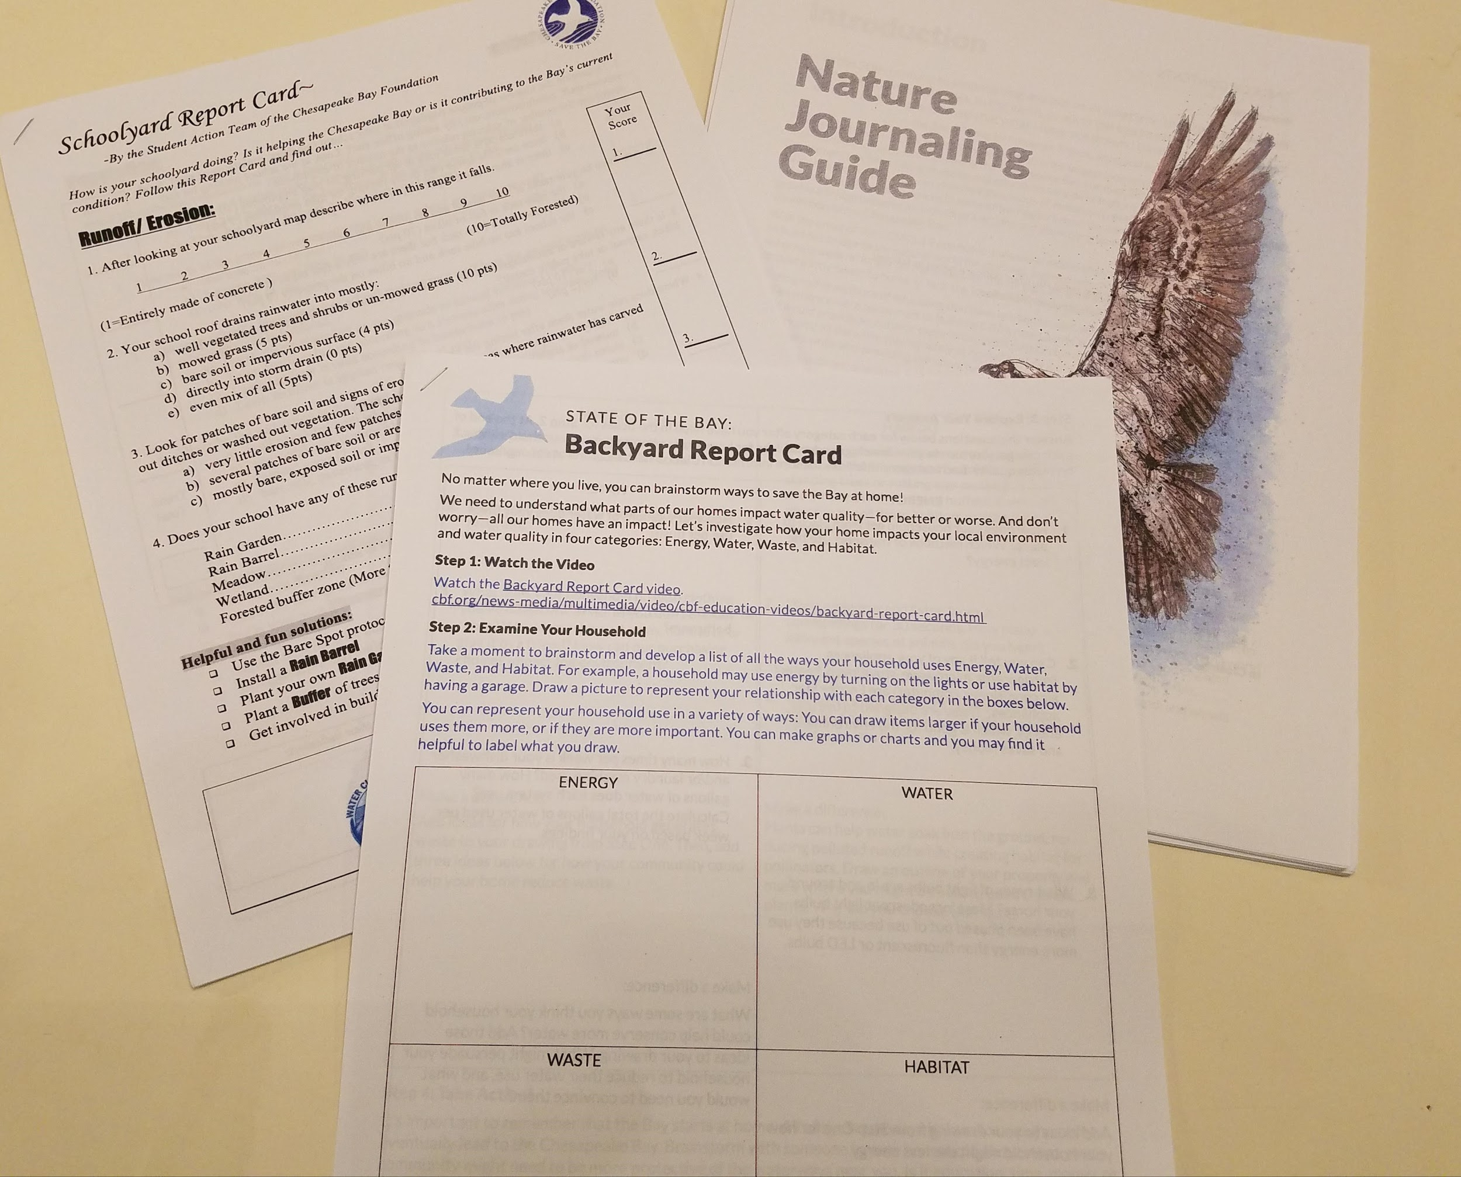
Tools to Support Student Inquiry
Inventories/Surveys/Audits
School Yard Report Card
Back Yard Report Card
Other Audits (NWF)
Nature Journaling
Notes:
Optional Slide - avail. Tools to support inquiry

Slide 23
Driving Question
Supporting Questions
How does our school’s energy use impact our local streams?
Where does our school’s energy come from?
Who makes decisions about energy use in the classroom?
How does energy use impact the climate?
How might climate change impact streams?
How do you measure the health of a stream?
What stream is closest to my school?
What are some ways you would lead your class to explore these questions if you were the classroom teacher?
Workshop
MWEE
Notes:
Example Option 1
How would you begin work to answer these questions on your own? What venues, where could you explore these issues?
If you were in a classroom, how would you encourage your students to begin inquiry around these driving and supporting processes?
For later - How can you translate this to your teachers - do this at the end of the session?

Slide 24
Driving Question
Supporting Questions
How does our school’s energy use impact our local streams?
Where does our school’s energy come from?
Who makes decisions about energy use in the classroom?
How does energy use impact the climate?
How might climate change impact streams?
How do you measure the health of a stream?
What stream is closest to my school?
Workshop
MWEE
Notes:
Example option 2

Slide 25
The Ask
Conduct the investigation and add to the shared slide deck (you will be adding 2 slides)
Notes:
VIRTUAL OPTION: https://docs.google.com/presentation/d/1E2RxDGCn9CD6Ul27jwQdS6x_RQYdrjtf/edit?usp=sharing&ouid=117634018940137766028&rtpof=true&sd=true

Slide 26
Synthesis and Conclusion: ‘The Ask’
Slide 1
What supporting/investigative question did you focus on?
What conclusions can be drawn based on the information and data you collected and synthesized?
What more do you need to know? Were there new questions that popped up? What additional research and/or data do you need now?
Slide 2
Design a graphic representation of the data collected and information learned (graph/chart)
Workshop
MWEE
Notes:
Virtual Option: https://docs.google.com/presentation/d/1HMWV6pMvAiELH-AxZeUPGdV9r3KdBfDsiWVPbeoBHtY/edit?usp=sharing

Slide 27
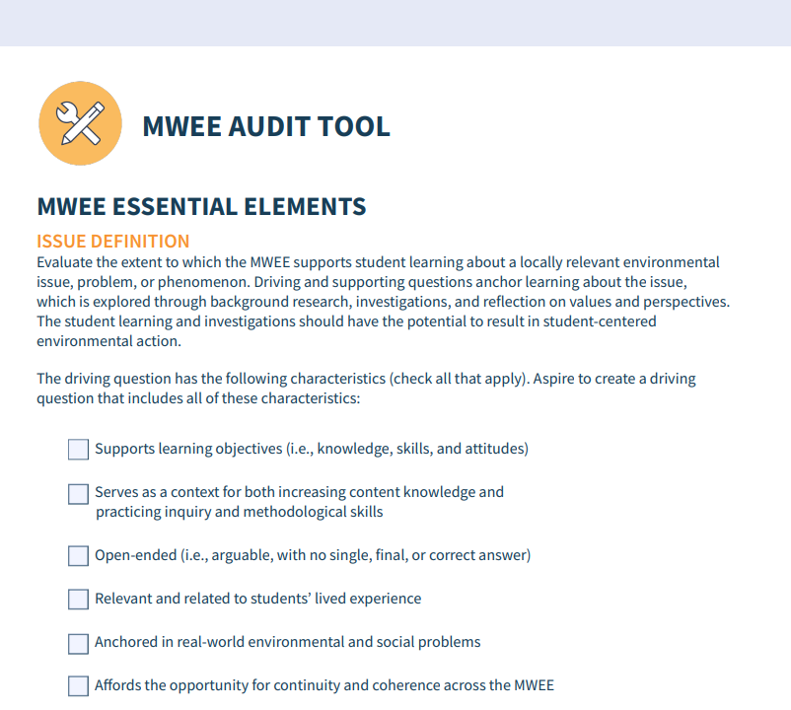
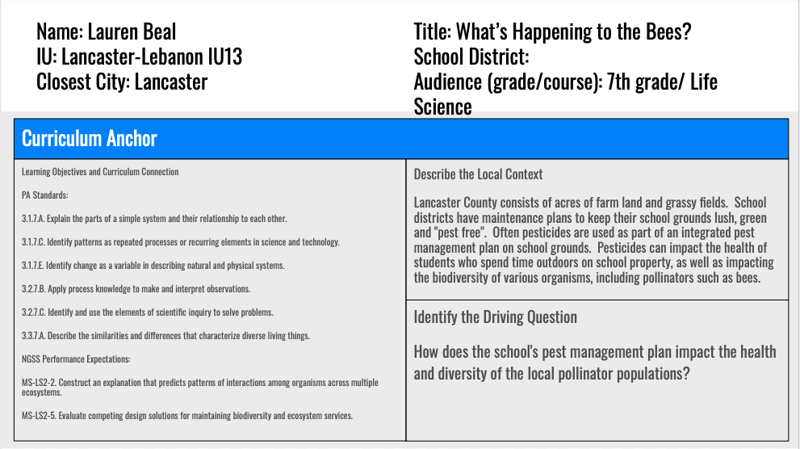
ELM - Curriculum Anchor Reflection
In small groups share ELM and Provide feedback (consider using the MWEE Audit)
Notes:
Virtual Option: 3 PERSON BREAK outs
Breakout Guidance: ELM Curriculum Anchor Discussion
In this breakout we ask that each group member share the curriculum anchor section of the ELM Planning Doc. with your colleagues. These are the Curriculum Anchor slides you all added to this google slide deck detailing the Learning Objectives/Curricular Connections, the Local Context and the Driving Question.
In this discussion about each of the MWEEs we hope each member of the breakout group can both provide and receive feedback on this part of the ELM. Consider using the MWEE Audit Tool (Classroom Integration, Issue Definition and Local Context sections) to help you organize any feedback you are providing.

