Slide 1
Issue Investigation

Slide 2
Activity 1
Youth Voice

Slide 3
What does it mean to support youth voice?
What are you doing in your classroom or programs to support youth voice?
What are the biggest benefits for supporting youth voice? What are the biggest challenges in supporting youth voice?

Slide 4
Driving Question
Supporting Questions
[Workshop Driving Question here]
[Workshop Supporting Questions from Part 2 here]

Slide 5
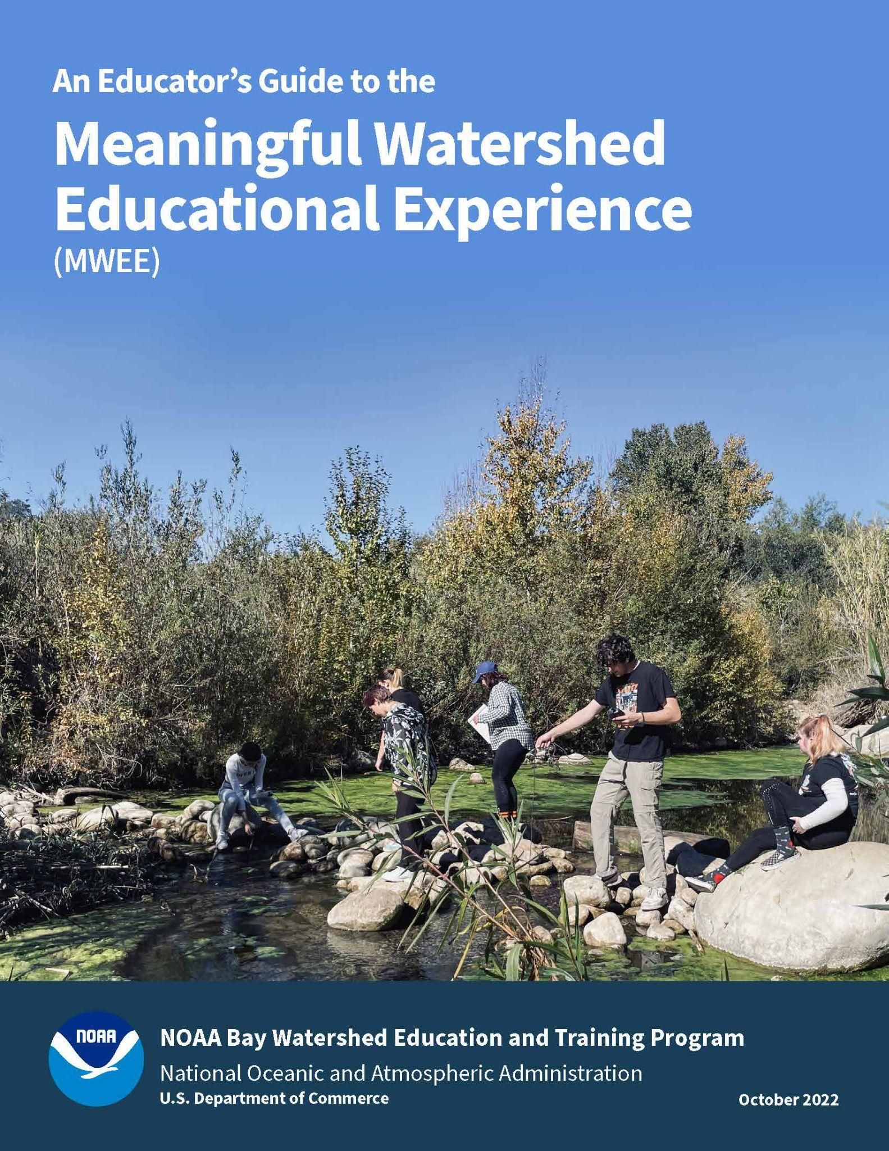
How could you best support youth voice during the development of supporting questions?
Page 11

Slide 6
Activity 2
Modeling an Investigation

Slide 7
Driving Question
Supporting Questions
[Workshop Driving Question here]
[Workshop Supporting Questions from Part 2 here]

Slide 8
Considerations while Planning an Investigation (as the student)
DATA | COLLECTION | LOGISTICS
What data already exists? What prior knowledge must we learn? Where can we find this information? | What tools do we have? What is the study site like and what type of data can we collect there? How will we collect data? What are our procedures? What roles/jobs are required to collect the data? | How much time do we have at the site? How many students will be at the site? Are there safety concerns?

Slide 9
Before we go outside…
What do we need to consider to make this a safe, effective, and manageable experience?
Notes:
Ask the group to brainstorm things to consider: classify them into categories: safety, class management and logistics

Slide 10
Synthesis and Conclusion
Be prepared to report the following:
What supporting question did you focus on?
Briefly describe how your field work went.
What conclusions can be drawn based on the information and data you collected and synthesized?
Communicate (pictures/charts/graph) what your conclusions were and how they relate to the Driving Question and Local Issue.
What more do you need to know? Were there new questions that popped up? What additional research and/or data do you need now?

Slide 11
Design a graphic representation of the data collected and information learned

Slide 12
Outdoor Field Experiences
Successes/Challenges
Supporting individual or group work outside
Connecting to class work
Assessing student learning
What learning happens best outside?

Slide 13
Activity 3
Outdoor Field Experiences in Maryland

Slide 14
Explore nearby Outdoor Field Experience locations
Find your Park findyourpark.com
Page 17
Notes:
[Make additions/subtractions and sub out webpages based on the location of your workshop]

Slide 15
Activity 4
Issue Investigation - More than Outdoor Field Experiences

Slide 16
ShoreRivers + Dorchester & Talbot County 3rd Grade
How do outdoor field experiences help to answer or look more deeply at the driving question/supporting questions?
Which learning objectives or standards do the outdoor field experiences help to address?
How was each outdoor field experience contextualized to give it more meaning?
How do indoor lessons and components support the overall issue investigation?
How might the indoor components provide students the opportunity to translate existing knowledge to the investigation?

Slide 17
Activity 5
Plan it!

Slide 18
Planning your MWEE!
Complete the Incorporating Outdoor Field Experiences worksheet (pages 18-20)
Complete the Issue Investigation section (pages 24-25) of the Environmental Literacy Model (ELM)
Reference the MWEE Audit Tool (pages 37-54) for additional guidance
Use each other to bounce off ideas!

