Slide 1
PART 3:
Issue Investigation
Activity 3.1 • Youth Voice
Activity 3.2 • Modeling an Investigation
Activity 3.3 • Outdoor Field Experiences in Delaware
Activity 3.4 • Issue Investigation – More than Outdoor Field Experiences
Activity 3.5 • Plan It

Slide 2
Activity 3.1
Youth Voice

Slide 3

What does it mean to support youth voice?
_________________________________
What are you doing in your classroom or programs to support youth voice?
_________________________________
What are the biggest benefits for supporting youth voice? What are the biggest challenges in supporting youth voice?

Slide 4

Driving Question
Supporting Questions
How does litter and trash in our school yard impact our local environment?
[Workshop Supporting Questions from Part 2 here]

Slide 5
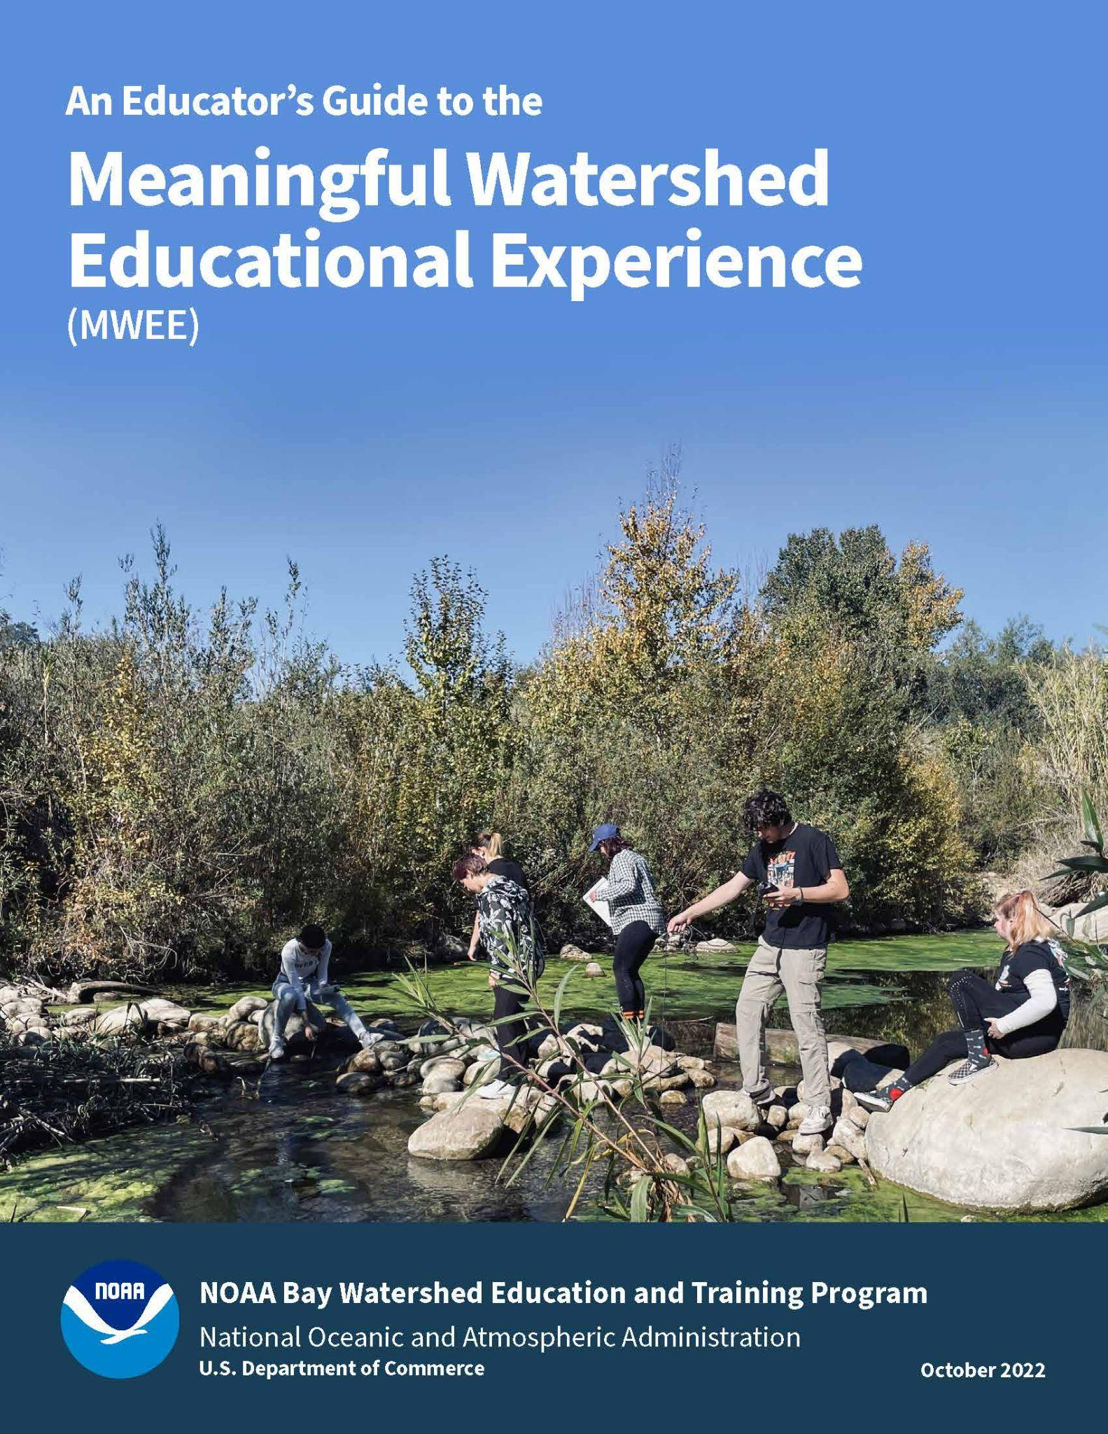
How could you best support youth voice during the development of supporting questions?
Page 11

Slide 6
Activity 3.2
Modeling an Investigation

Slide 7
Driving Question
Supporting Questions
How does litter and trash in our school yard impact our local environment?
[Workshop Supporting Questions from Part 2 here]

Slide 8
Considerations while Planning an Investigation
(as the student)
DATA | COLLECTION | LOGISTICS
What data already exists? What prior knowledge must we learn? Where can we find this information? | What tools do we have? What is the study site like and what type of data can we collect there? How will we collect data? What are our procedures? What roles/jobs are required to collect the data? | How much time do we have at the site? How many students will be at the site? Are there safety concerns?

Slide 9
Before we go outside…
What do we need to consider to make this a safe, effective, and manageable experience?
Notes:
Ask the group to brainstorm things to consider: classify them into categories: safety, class management and logistics

Slide 10
Synthesis and Conclusion
Be prepared to report the following:
What supporting question did you focus on?
Briefly describe how your field work went.
What conclusions can be drawn based on the information and data you collected and synthesized?
Communicate (pictures/charts/graph) what your conclusions were and how they relate to the Driving Question and Local Issue.
What more do you need to know? Were there new questions that popped up? What additional research and/or data do you need now?

Slide 11
Design a graphic representation of the data collected and information learned.

Slide 12
Outdoor Field Experiences
Successes/Challenges
Supporting individual or group work outside
Connecting to class work
Assessing student learning
What learning happens best outside?

Slide 13
Activity 3.3
Outdoor Field Experiences in Delaware

Slide 14
Explore nearby Outdoor Field Experience locations
Find your Park findyourpark.com
Page 17
Notes:
[Make additions/subtractions and sub out webpages based on the location of your workshop]

Slide 15
Activity 3.4
Issue Investigation – More than Outdoor Field Experiences

Slide 16
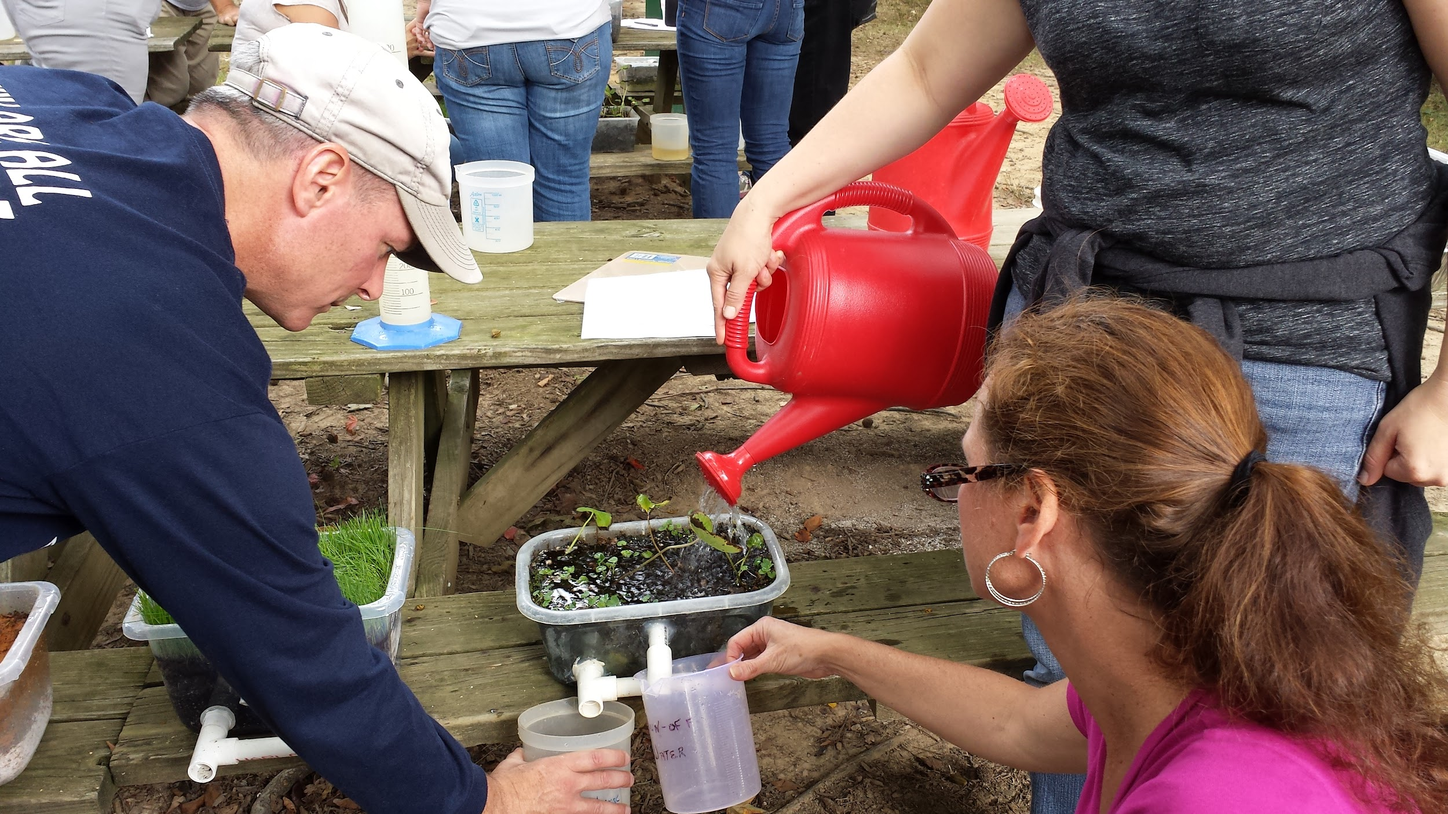

Case Study: FCPS + Blandy
How does this MWEE provide opportunities to explore the impacts of a local environmental issue?
Which characteristics of an effective driving questions are embodied in this example? (p. 28 MWEE Guide)
How are core ideas and practices of multiple disciplines defined and integrated into the MWEE?
Could exploration of this issue logically culminate in stewardship and/or civic action?

Slide 17
Case Study: FCPS / Blandy
How do outdoor field experiences help to answer or look more deeply at the driving question/supporting questions?
Which learning objectives or standards do the outdoor field experiences help to address?
How was each outdoor field experience contextualized to give it more meaning?
How do indoor lessons and components support the overall issue investigation?
How might the indoor components provide students the opportunity to translate existing knowledge to the investigation?

Slide 18

Activity 3.5
Plan it!

Slide 19
Planning your MWEE!
Complete the Incorporating Outdoor Field Experiences worksheet (pages 20-21)
Complete the Issue Investigation section (pages 24-25) of the Environmental Literacy Model (ELM)
Reference the MWEE Audit Tool (pages 27-35) for additional guidance
Use each other to bounce off ideas!

Slide 20
PART 3: Output & Deliverables
Activity 3.1
Participants recognize spaces where youth voice is supported and the benefits and challenges to supporting it.
Participants reflect on their own practice to identify places where they are already supporting youth voice and areas where they can improve.
Activity 3.2
Participants will experience a hands-on outdoor field experience where they investigate one or more supporting questions by designing an investigation, collect and synthesis data, and share their conclusions with the group.
Activity 3.3
Participants will complete the Incorporating Outdoor Field Experiences worksheet (page 18) of the MWEE Guide for the workshop’s modeled MWEE.
Activity 3.4
Participants become familiar wit hthe issue investigation pages of the ELM.
Participants will use the MWEE Audit Tool to evaluate the FCPS/Brandy MWEE Example.
Activity 3.5
Participants will complete the Incorporating Outdoor Field Experiences worksheet for their own MWEE.
Participants will complete the Issue Investigation pages of the ELM for their own MWEE.
Notes:
Page 14 - 15

