Slide 1
Curriculum Anchor

Slide 2
Activity 1
Exploring Local Issues

Slide 3
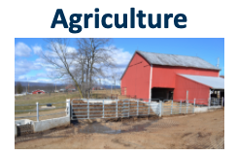
Learn the Issues
Review the issue cards describing common issues/problems within Pennsylvania Watersheds
Determine which are local to you - Pick 6 to work with
Using the issue descriptor cards, label each issue based on natural systems, human systems and values. Be prepared to defend your labels.
Notes:
Issue Cards: https://www.baybackpack.com/files/Documents//PA-Issue-Cards.pdf
Brainstorm watershed issues in your area
Share the jamboard (see links below)
Look at all the issues - learn a bit about all (7mins) (Issue Cards: https://www.baybackpack.com/files/Documents//PA-Issue-Cards.pdf ; Local Issue Docs:https://www.baybackpack.com/files/Documents/PA-Issue-Cards-Links.pdf )
Ask are there any missing:
After exploring all the issues pick six that we want to work with - for efficiency consider deleting the ones that are less relevant
Using the 6 issue descriptor cards, label each issue based on natural systems, human systems and values. Be prepared to defend your labels. (pile the unused ones in a group)

Slide 4
Learn the Issues: Discuss
What issues discussed are relevant to where you work and live?
Are you surprised by any of the issues identified?
Are there any major issues missing that are relevant to your community?
How else would you have students research locally relevant issues?

Slide 5
Activity 2
Connecting Issues with Questions and Standards

Slide 6
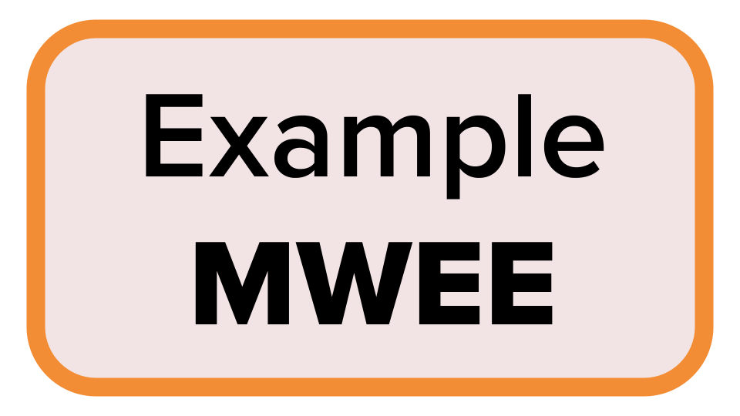
SIDE NOTE - Workshop logistics
Throughout this workshop, to build understanding and confidence around MWEEs we will….
Provide time for participants to develop their own MWEE or fine-tune an existing MWEE
Model a shared
Workshop MWEE
Reference an Example MWEE from Conestoga Valley High School

Slide 7
Issue Investigation
Break into small groups and investigate [the PA Water Issue you selected for this workshop - keep it locally relevant]
In your groups discuss…
Why is this issue important and how does it impact the health of Pennsylvania’s waterways and watersheds?
How might this issue connect to your teaching standards? Where does it fit into the scope and sequence? The existing curriculum? Are there opportunities for interdisciplinary learning (social studies, language arts, math, art, reading)?
Does this issue provide an actionable opportunity for students? How can students help advance some of the solutions that you explored on the issue page?
Let’s go outside!

Slide 8
How did your perceptions of the local issue/phenomena change after you went outside?
How do you see this difference benefiting your students?

Slide 9
Driving Question
[Add workshop driving question]
Standards/Learning Objectives/Curriculum

Slide 10
Driving Question
How do my actions play a role in our changing climate?
Notes:
NOTE This is an example Issue and Driving Question - workshop facilitators will need to ID the locally relevant issue and develop a driving question.

Slide 11
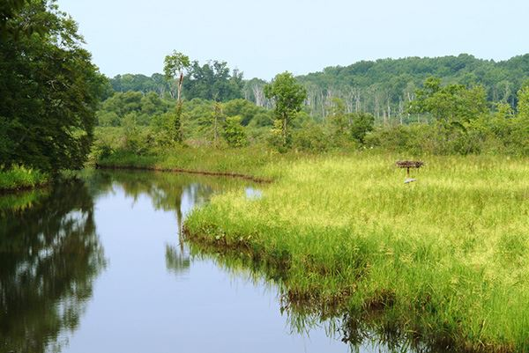

Slide 12
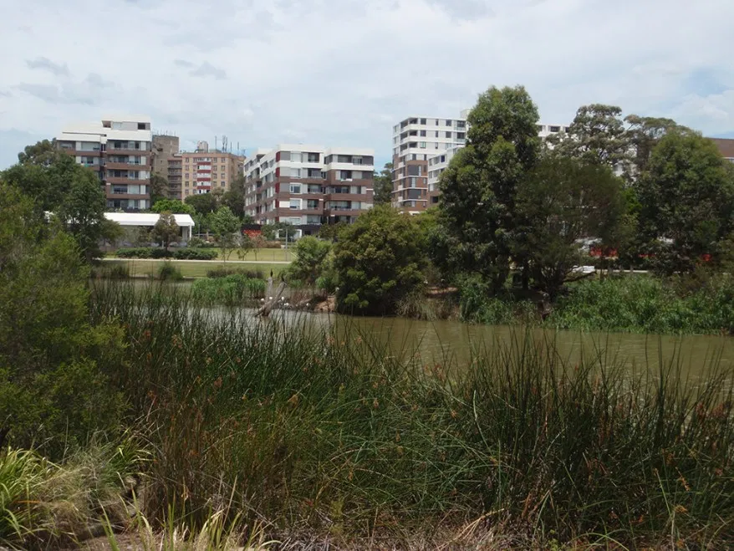

Slide 13
The Issue
Climate Change
Climate change refers to significant, long-term changes in weather patterns that result in warming temperatures and sea-level rise, unpredictable weather patterns and increased storm intensity.” The effects of climate change threaten the environment, human health and well-being, and the economy.
Find Out More: https://tinyurl.com/y62ymmjg
Notes:
Example Issue

Slide 14
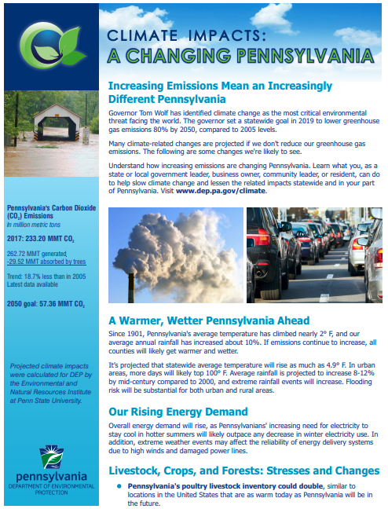
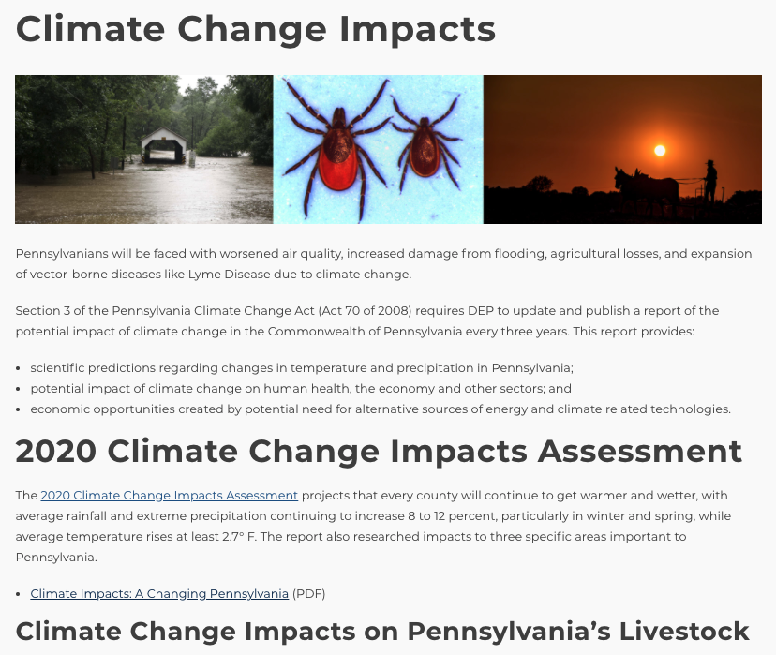
The Issue: Climate Change
Notes:
Example Issue
https://www.dep.pa.gov/Citizens/climate/Pages/impacts.aspx

Slide 15
The Issue: Climate Change
Why is this issue important and how does it affect the health of Pennsylvania’s environment, waterways, watersheds and communities?
How might this issue connect to your teaching standards?
Where does it fit into the scope and sequence? The existing curriculum?
Are there opportunities for interdisciplinary learning (social studies, language arts, mathematics, art, reading?)
Notes:
Example Issue
https://www.dep.pa.gov/Citizens/climate/Pages/impacts.aspx

Slide 16
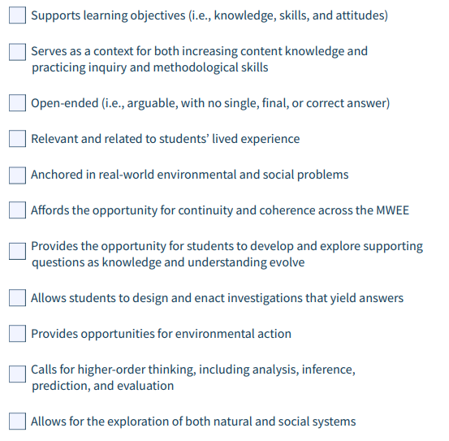
Driving Question
How do my actions play a role in our changing climate?
Notes:
Example Issue - using driving question rubric from MWEE Audit Tool:
https://www.baybackpack.com/files/MWEE-Audit-Tool_2025-04-17-171025_jndt.pdf

Slide 17
Driving Question - Refined
How does our school’s energy use impact our local streams?

Slide 18
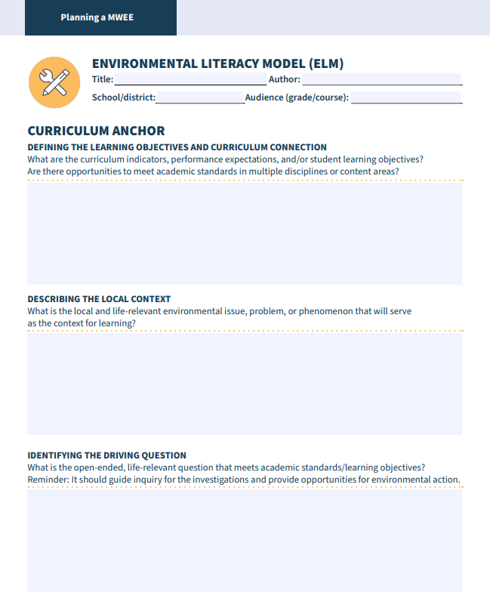
Environmental Literacy Model (ELM)
Learning Objectives
Curriculum Anchor
Issue Definition
Informed Action
Local Context
Driving Question

Slide 19
Supporting Questions
Brainstorming
[Insert Workshop Driving Question]

Slide 20
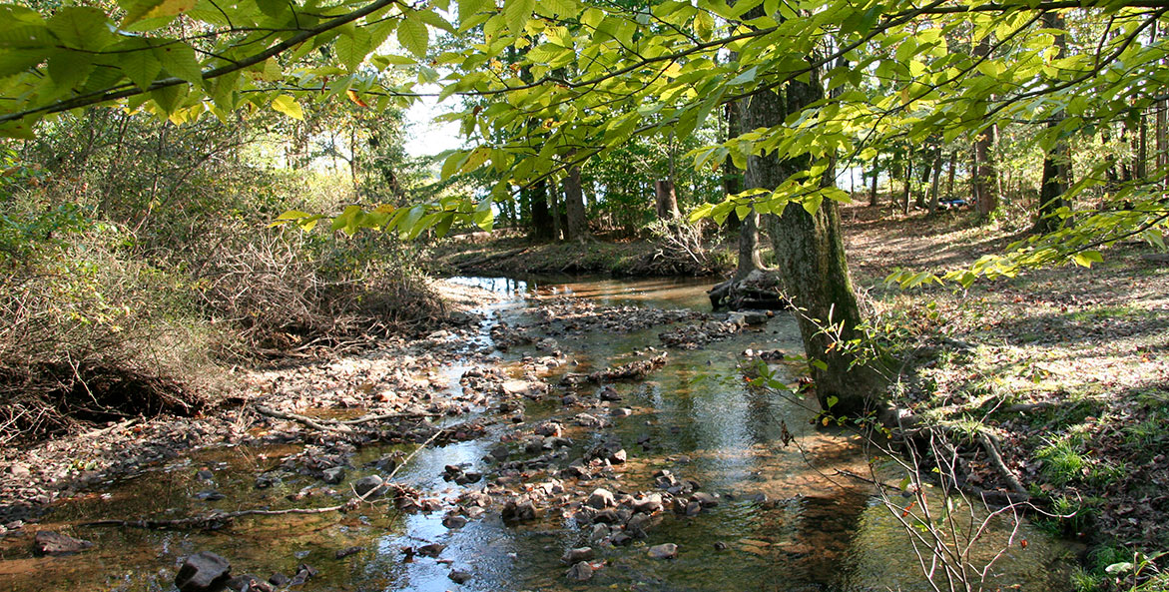
DQ: How does our school’s energy use impact our local streams?
Supporting Question
Supporting Question
Supporting Question
Notes:
Example Issue
Supporting questions help find the missing information needed to answer the driving question. Ideally, they are generated by the students or co-developed by students and educators. They should uncover the students' current knowledge about the issue, create interest, and begin to frame an investigation that addresses the driving question in a local context.
Supporting questions provide an opportunity to bring in a variety of subject disciplines, strengthening the life-relevant and authentic contexts for learning.

Slide 21
Supporting Questions
Brainstorming
DQ: How does our school’s energy use impact our local streams?
In the breakouts use the stickies and thumbs up to brainstorm and discuss potential supporting questions
Notes:
VIRTUAL OPTION
Go to Breakouts
(Use the next slide as a template for this activity)
Supporting questions help find the missing information needed to answer the driving question. Ideally, they are generated by the students or co-developed by students and educators. They should uncover the students' current knowledge about the issue, create interest, and begin to frame an investigation that addresses the driving question in a local context.
Supporting questions provide an opportunity to bring in a variety of subject disciplines, strengthening the life-relevant and authentic contexts for learning.

Slide 22
The Issue:
Driving Question:
Supporting Question Ideas
Connecting to Learning Standards
Type here
Type here
Type here
Type here
Type here
Type here
Type here
Type here
Type here
Type here
Type here
Type here
Type here
Type here
Type here

Slide 23
Notes:
Example of a Virtual option exercise

Slide 24
Supporting questions
DQ: How does our school’s energy use impact our local streams?
What is our energy use?
Why does it matter?
How do we measure it?
Where are our streams?
Why do they matter?
What is happening to them?
Notes:
This is what the students can do!
Supporting Question Triage (guided inquiry - more or less teacher guidance as needed) - if questions are specific in your LEA, those should be supporting questions
Could the question be investigated in a classroom
Investigated Outside
Supportive of Learning Goals/Stds.
Support student action

Slide 25
How does our school’s energy use impact our local streams?
Investigative Questions
Descriptive Questions
Correlative Question
Comparative Questions
Notes:
OPTIONAL: If facilitators want to dig into investigative questions consider using this resource to do so (there is an activity about categorizing questions and defining the investigative question types): The Association of Fish and Wildlife Agencies developed Using Outdoor Environments to Foster Student Learning of Scientific Practices, a useful resource that recognizes three main types of investigative questions.
Descriptive investigations involve describing and/or quantifying parts of a natural system.
Comparative investigations involve collecting data on different populations/organisms, or under different conditions (e.g. times of year, locations), or making a comparison.
Correlative investigations involve measuring or observing two variables and searching for a relationship.

Slide 26
What standards/learning objectives can be addressed with these supporting questions?
What sort of investigations might you do to answer these questions?
Which questions are best explored indoors? Which are best explored outdoors?

Slide 27
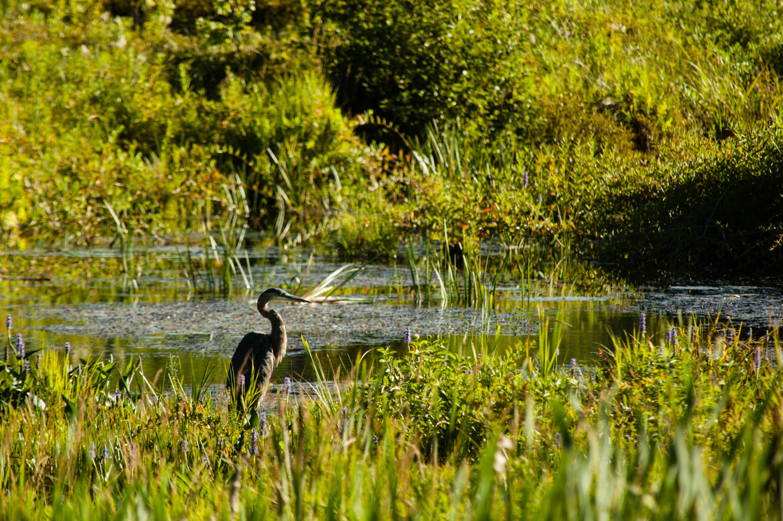
The Outside: Has both Answers and Questions

Slide 28
Activity 3
Introducing Action Early

Slide 29
Have you been involved in environmental or social action?
How did you get involved? What did it mean to you then? Now?

Slide 30
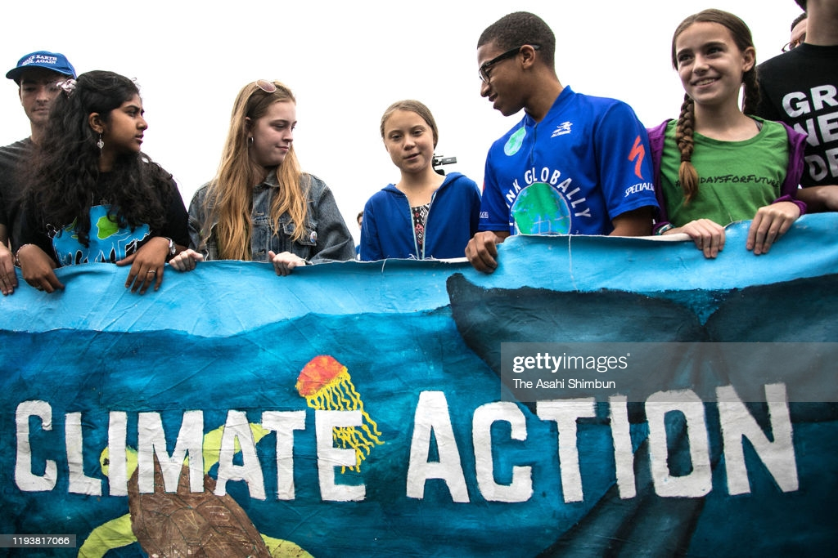
Types of Action
Restoration or Protection
Everyday Choices
Community Engagement
Civic Engagement

Slide 31
How to achieve meaningful action
Factors influencing individual choices and actions
Perceived locus of control for affecting change
Degree of lasting impact on an individual’s stewardship behaviors
What are the benefits to engaging students in action?
What are some successes and challenges to engaging students in action?

Slide 32
Issue: Climate Change
DQ: How does our school’s energy use impact our local streams?
Can you think of potential locally relevant informed actions your students might be interested in taking?
Notes:
Action Local must be tied back to DQ and to data collected during the issue definition and exploration.

Slide 33
Activity 4
Introducing the MWEE Planning Tools

Slide 34
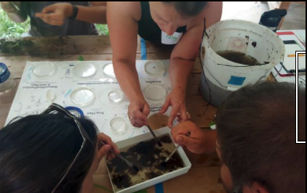
Case Study - Conestoga Valley High School
How does this MWEE provide opportunities to explore the impacts of a local environmental issue?
Which characteristics of an effective driving questions are embodied in this example? (p. 8 MWEE Guide)
How are core ideas and practices of multiple disciplines defined and integrated into the MWEE?
Could exploration of this issue logically culminate in stewardship and/or civic action?
Notes:
Conestoga Valley HS ELM Materials:
Conestoga Valley Think Cloud
https://www.baybackpack.com/files/Documents/Conestoga-Valley-Think-Cloud.pdf
Conestoga Valley Questions and Planning Investigations
https://www.baybackpack.com/files/Documents/Conestoga-Valley-Questions-and-Planning-Investigations.pdf
Conestoga Valley Moving from Claims to Informed Action
https://www.baybackpack.com/files/Documents/Conestoga-Valley-Moving-from-Claims-to-Informed-Action.pdf
Conestoga Valley ELM
https://www.baybackpack.com/files/Documents/Conestoga-Valley-ELM.pdf
Conestoga Valley ELM Curriculum Anchor
https://www.baybackpack.com/files/Documents/Conestoga-Valley-ELM-Curriculum-Anchor.pdf
Conestoga Valley ELM Issue Investigation
https://www.baybackpack.com/files/Documents/Conestoga-Valley-ELM-Issue-Investigation.pdf
Conestoga Valley ELM Informed Action
https://www.baybackpack.com/files/Documents/Conestoga-Valley-ELM-Informed-Action.pdf

Slide 35
Activity 5
Plan it!
Your
MWEE

Slide 36
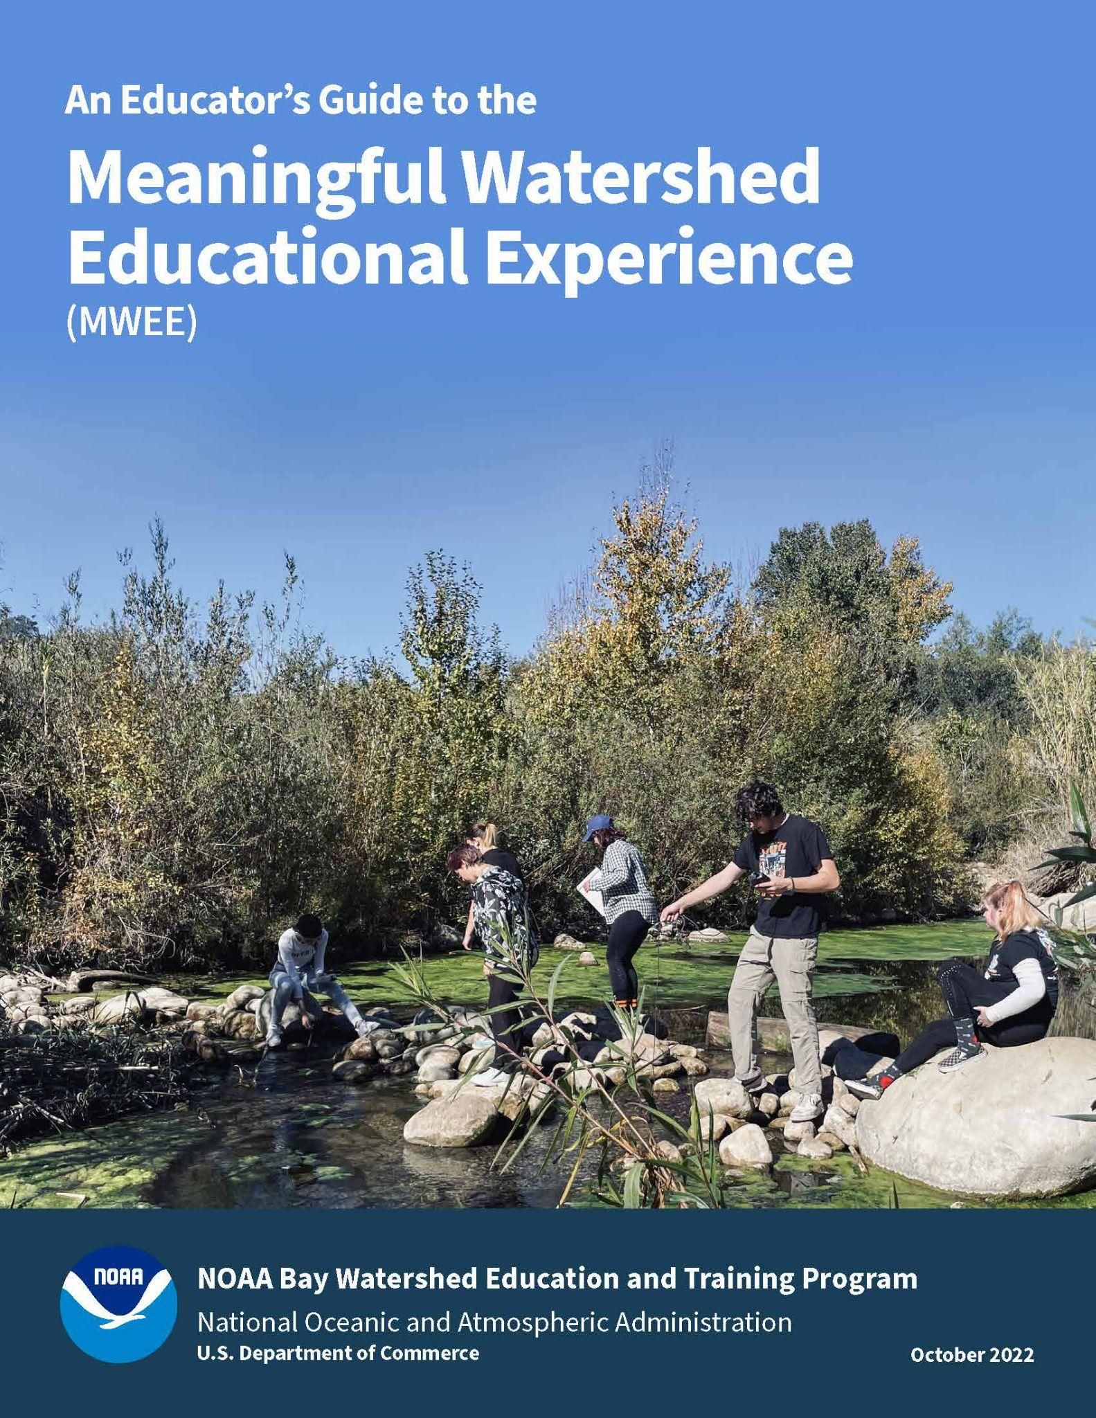
Start planning your MWEE!
Complete the Developing and Supporting Questions worksheet (page 18)
Complete the Curriculum Anchor section (page 23) of the Environmental Literacy Model (ELM)
Reference the MWEE Audit Tool (pages 27-35) for additional guidance
Use each other to bounce off ideas!
Your
MWEE
Notes:
VIRTUAL OPTION: https://www.baybackpack.com/files/Virtual_ELM-1.pdf

Slide 37
Additional Resources

Slide 38
Policies and Practices
Public Policy | Private Policy | Community Practice
Written by the government (federal, state, tribal, or local) | Created by businesses, organizations, or other established groups | The habits and behaviors of people

Slide 39
Defining the policies and practices that impact your MWEE issue may take time.
How do you see this step benefitting your students?

Slide 40
Action in our Climate Change MWEE
DQ:
DQ: How does our school’s energy use impact our local streams?
Think about our course MWEE
Can you think of potential actions students might be interested in

Slide 41
What is Environmental Justice?

Slide 42
PA EJ Definition and Issues
Environmental Justice Area defined by the census as communities with at least 30% people of color and/or 20% low-income levels.
66 of 67 PA Counties have Environmental Justice Areas ; approximately 30% of the entire state population lives in an EJA.
Environmental Indicators
Partnerships with DEP Office of EJ
Notes:
EPA and DEP define environmental justice as
Environmental justice is the fair treatment and meaningful involvement of all people regardless of race, color, national origin, or income, with respect to the development, implementation, and enforcement of environmental laws, regulations, and policies. This goal will be achieved when everyone enjoys:
The same degree of protection from environmental and health hazards, and
Equal access to the decision-making process to have a healthy environment in which to live, learn, and work.
DEP defines an EJ Area as any census tract where 20 percent or more individuals live at or below the federal poverty line, and/or 30 percent or more of the population identifies as a non-white minority, based on data from the U.S. Census Bureau and the federal guidelines for poverty.
The EJ index is a combination of environmental and demographic information. There are eleven EJ Indexes in EJSCREEN reflecting the 11 environmental indicators. The 11 EJ Index names are:
National Scale Air Toxics Assessment Air Toxics Cancer Risk
National Scale Air Toxics Assessment Respiratory Hazard Index
National Scale Air Toxics Assessment Diesel PM (DPM)
Particulate Matter (PM2.5)
Ozone
Lead Paint Indicator
Traffic Proximity and Volume
Proximity to Risk Management Plan Sites
Proximity to Treatment Storage and Disposal Facilities
Proximity to National Priorities List Sites
Wastewater Discharge Indicator
Commonwealth of Pennsylvania has identified 1,015 Environmental Justice Areas (EJA)
66 of 67 counties
The majority of Pennsylvania schools and districts categorized as Title 1 or via Every Student Succeeds Act as “Comprehensive Improvement” or “Targeted Support and Improvement” schools are located within or close to EJA’s
Understanding child's developmental vulnerability, (e.g. organ systems sensitivity to environmental stressors, frequently more heavily exposure to toxic substances than adults), it is logical to reason that children in minority, low-income, and other underserved populations, as well as children with disabilities, often experience exponentially higher exposures to multiple environmental contaminants where they live, learn, and play, placing them at a disproportionate risk for associated health effects
DEP EJ Map http://dep.pa.gov/EJViewer
https://www.epa.gov/ejscreen/overview-environmental-indicators-ejscreen
https://video.witf.org/video/justice-in-chester-ajz2de/

Slide 43
Environmental Justice Movement:
Legislative Connections to Education
1968 - The environmental justice movement started
Title VI of the Civil Rights Act prohibits recipients of federal financial assistance (states, grantees, etc.) from discriminating based on race, color, or national origin in any program or activity.
“Environmental racism” coined by Dr. Benjamin Chavis in 1982 to describe a growing body of evidence that landfills and other polluting facilities in the U.S. were disproportionately sited in or near non-white communities.
1994 - Executive Order 12898
2011 - Environmental Justice IWG established a Title VI Committee to address the intersection of agencies' environmental justice efforts with their Title VI enforcement and compliance responsibilities.
EJ meets Ed: Concerns touch not only environmental resource management and protection fields but also education agencies.
Title 1
ESSA NCLI Amendment (2015)
Notes:
Professor Robert Bullard wrote, "whether by conscious design or institutional neglect, communities of color in urban ghettos, in rural 'poverty pockets', or on economically impoverished Native-American reservations face some of the worst environmental devastation in the nation."
1968 - The environmental justice movement was started by individuals, primarily people of color, who sought to address the inequity of environmental protection in their communities.
“Environmental racism” coined by Dr. Benjamin Chavis in 1982 to describe a growing body of evidence that landfills and other polluting facilities in the U.S. were disproportionately sited in or near Black communities.
1994 - Executive Order 12898 was issued to direct Federal agencies to incorporate achieving environmental justice into their mission and directs federal agencies to identify and address, as appropriate, disproportionally high adverse human health and environmental effects of their programs, policies, and activities on minority populations and low-income populations.all programs or activities receiving Federal financial assistance that affect human health or the environment do not directly, or through contractual or other arrangements, use criteria, methods, or practices that discriminate on the basis of race, color, or national origin.
In accordance with Title VI of the Civil Rights Act of 1964, each Federal agency shall ensure that all programs or activities receiving Federal financial assistance that affect human health or the environment do not directly, or through contractual or other arrangements, use criteria, methods, or practices that discriminate on the basis of race, color, or national origin. It prohibits recipients of federal financial assistance (states, grantees, etc.) from discriminating based on race, color, or national origin in any program or activity.
Combined EJ Concerns touch not only environmental resource management and protection fields but also education agencies. Thus his applies to all federally funded programs including itile
https://www.dep.pa.gov/Citizens/climate/Pages/impacts.aspx

Slide 44
EJ and MWEE
ID issues and indicators through an EJ lens
Environment as an Integrative Concept (EIC)
Interdisciplinary entry points for inquiry
Transformative education
EJ impacts everyone
Hyper
local
Personal
Compare prevalence of issues in EJ Areas
Action connected to watershed address: influencer or experiencer
PA DEP EJ Area
My Waterway (EPA)
EPA EJ Screen
Notes:
EJ Issues
pay attention to equity and action but also use EJ as a channel into environmental issues
Transformative education: towards a relational, justice-oriented approach to sustainability
Transformative education: towards a relational, justice-oriented approach to sustainability Transformative learning (TL) that fosters a shift in consciousness towards a more ecological approach is an inherently place-based phenomenon
Compassion not Demagogy
Three key themes which emerge from the literature: (re-) connection, (self-)compassion and creativity. (Re-)connection involves all processes that evoke an experience of the interconnected nature of all life. (Self-)compassion, acting to alleviate suffering or doing the least harm, naturally follows a sense of interconnection. Creativity is the materialisation of a sense of interconnection and compassion or the means through which these can be experienced. This theoretical framework can be used empirically to research the extent to which people involved in place-based sustainability initiatives develop an ecological consciousness
https://mywaterway.epa.gov/
https://ejscreen.epa.gov/mapper/
https://padep-1.maps.arcgis.com/apps/webappviewer/index.html?id=f31a188de122467691cae93c3339469c

Slide 45
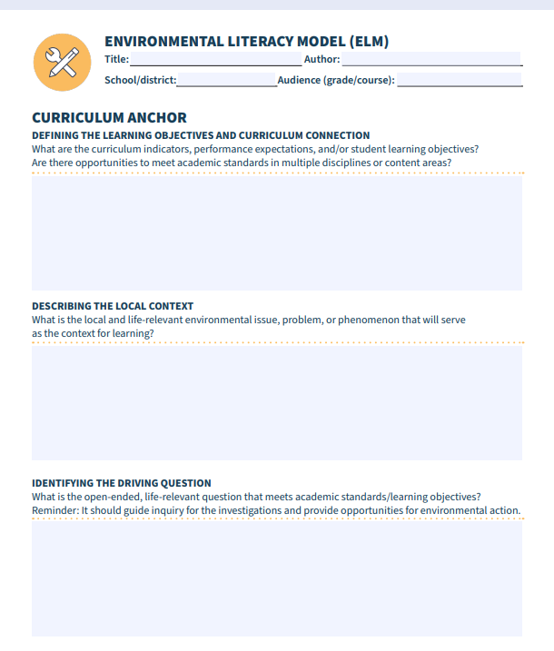
Planning Your MWEE
The Environmental Literacy Model

Slide 46
Environmental Literacy Model (ELM)
Resource for planning and describing the details of a MWEE
Situates the MWEE within the scope and sequence of the curriculum
Resource for communicating about the MWEE with partners, administrators, and the community
Developed By Chesapeake Bay Foundation in support of the MD Environmental Literacy Partnership (MELP) Initiative
Curriculum Anchor
Issue Investigation
Informed Action

Slide 47
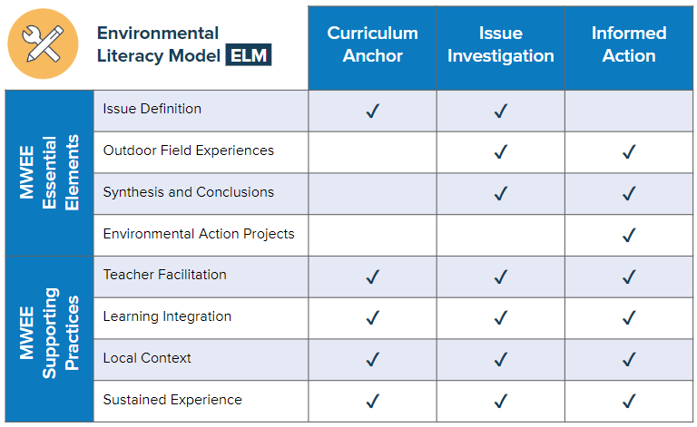
ELM Framework
Notes:
Connections to Essential Elements - EEs are not linear, they can be cyclical in the context of a MWEE. Some MWEEs start with OFE, or ideally have multiples rounds of experiences and learning that feeds the MWEE

Slide 48
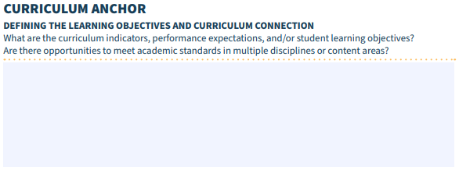
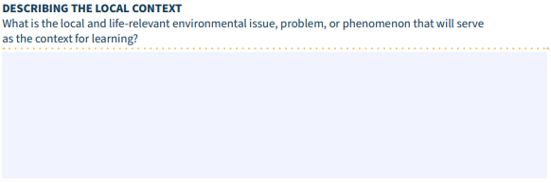
Curriculum Anchor
Notes:
Essential to connect to what is going on in the classroom - not extra, not an isolated experience. Also, Life relevant, why might the students be authentically engaged in this MWEE, relevancy

Slide 49
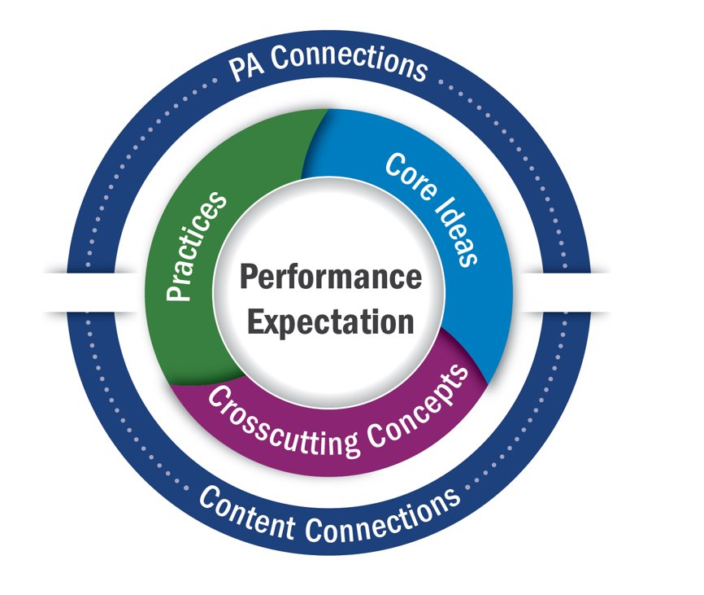
Curriculum Anchor
Standards
Issues/Local Context
Driving Question
Pennsylvania State Board
of Education
Proposed PA Academic Standards
Notes:
Curriculum Anchor
1-Investigate issues found on CBP, practice identifying issues in an outdoor space, develop supporting questions
2-Discuss benefits and motivators of action
3-Introduced to the Workshop’s modeled MWEE (which participants develop and work through during the workshop) and Example MWEE by ShoreRivers
4-Start working on their MWEE - this could be brand new, worked on individually or as a group, opportunity to learn about a new but developed MWEE, chance to reflect and improve a current MWEE, etc.

Slide 50
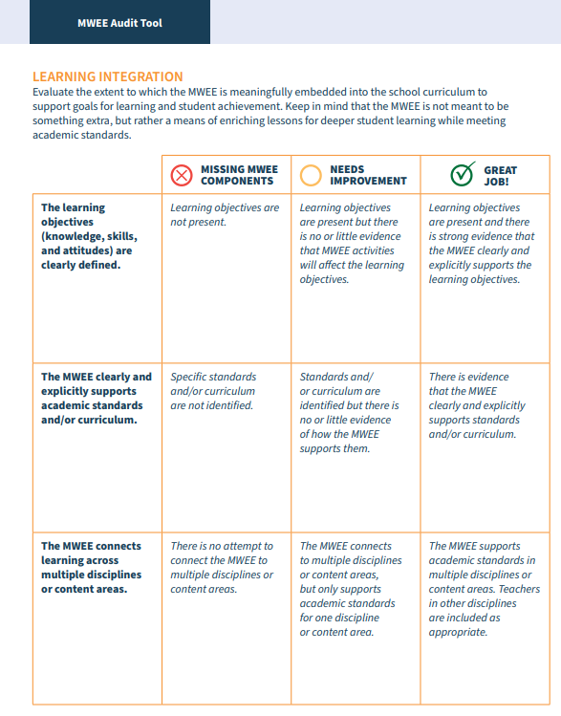
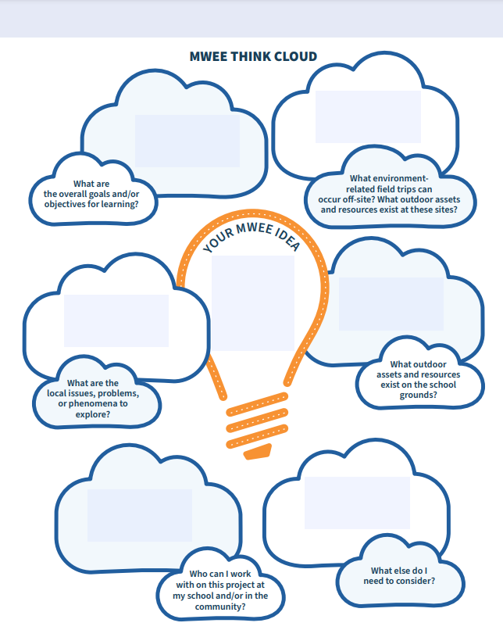
Curriculum Anchor
Notes:
Curriculum Anchor
1-Investigate issues found on CBP, practice identifying issues in an outdoor space, develop supporting questions
2-Discuss benefits and motivators of action
3-Introduced to the Workshop’s modeled MWEE (which participants develop and work through during the workshop) and Example MWEE by ShoreRivers
4-Start working on their MWEE - this could be brand new, worked on individually or as a group, opportunity to learn about a new but developed MWEE, chance to reflect and improve a current MWEE, etc.

Slide 51
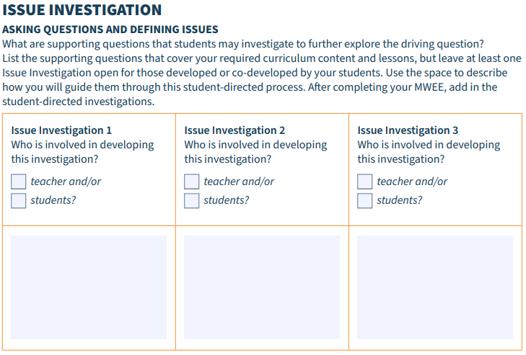
Issue Investigation
Notes:
Evolution of ELM - Heard from the EL community that the ELM as originally designed had some issues. describe multiple lines of investigation, exploring multiple student derived questions, etc. Students role in shaping the MWEE is highlighted. Asking questions, planning investigations, analyzing data and communicating what was discovered, making a claim

Slide 52
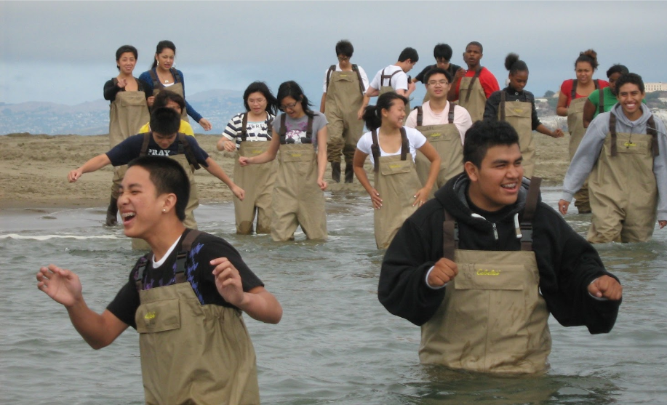
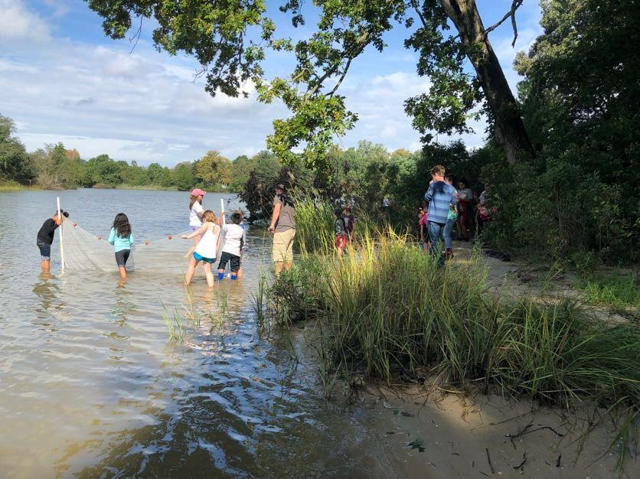
Issue Investigation
Notes:
Issue Investigation
1-Discuss student voice, and when and how to use it during the MWEE
2-Model an outdoor investigation
GOAL: Participants have methods and ideas of how to incorporate student voice and practice designing and conducting an outdoor investigation

Slide 53
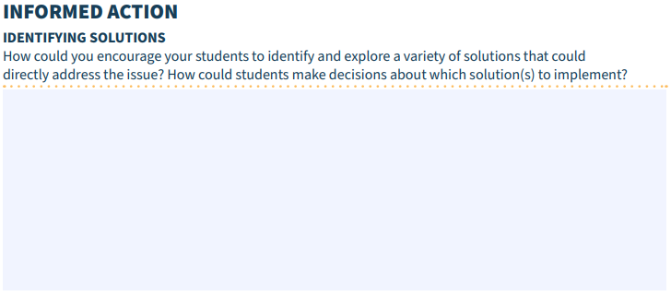
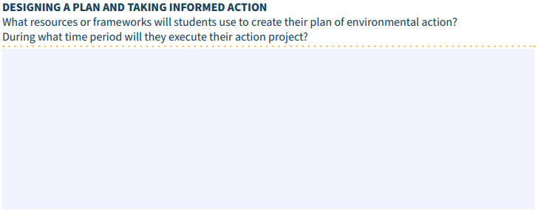
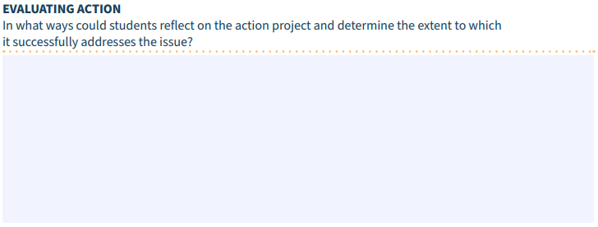
Informed Action
Notes:
Student Focus in the action component - taking and evaluating the impact of the action.
ELM’s not perfect, just a tool, regarding action (a challenge in MWEE) work with Earth Force to understand challenges and connect

Slide 54
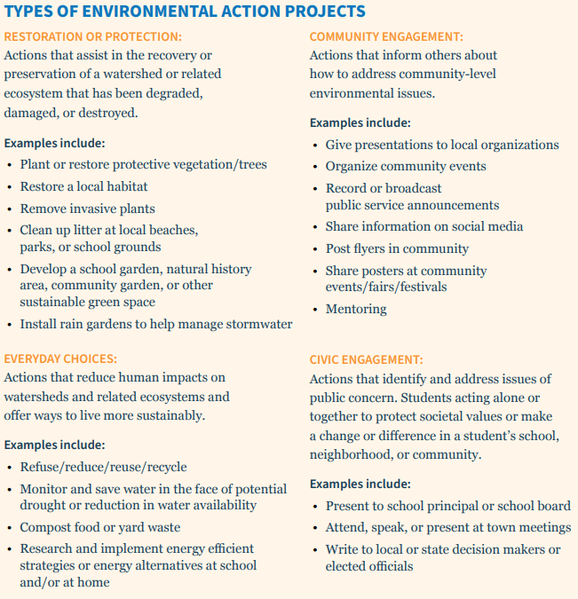
Informed Action
C laim
E vidence
R easoning
Notes:
Stewardship & Civic Action
1-Form a Claims-Evidence-Reasoning statement and use that statement to connect an action idea to the investigated issue
2-Practice bolstering student voice for choosing action projects
3-Practice a method for narrowing student’s action ideas based on constraints and forming an action plan
GOAL: Participants learn how to lead a group of students through synthesis of data, choosing an action project and planning the project.

Slide 55
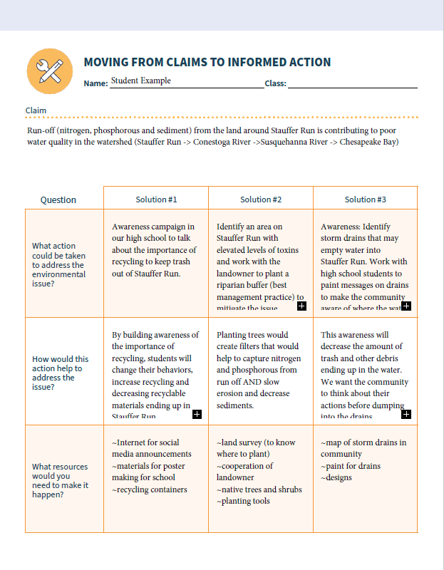
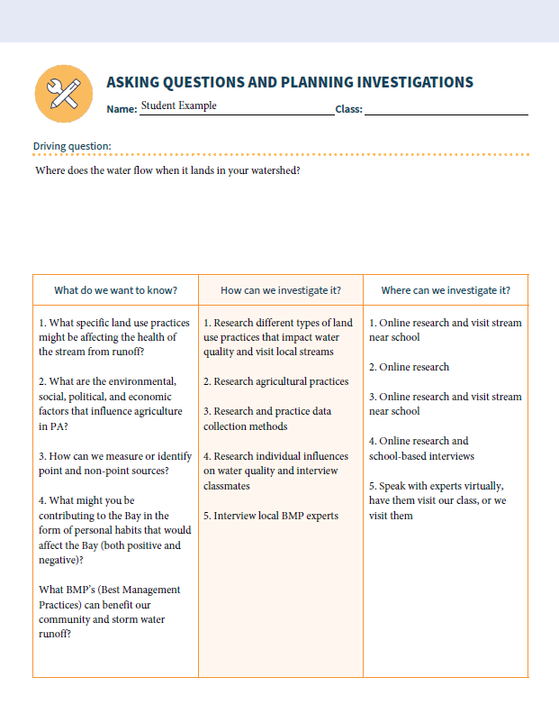
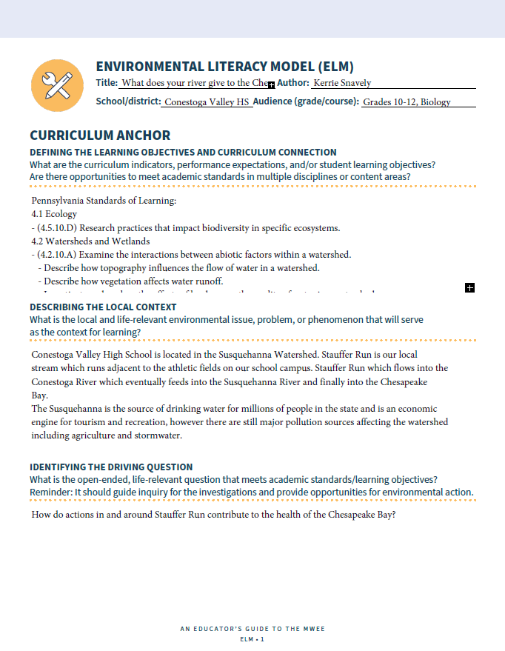
Some Examples to Support Your Work
Conestoga Valley High School

