Slide 1
Curriculum Anchor

Slide 2
Activity 1
Exploring Local Issues

Slide 3
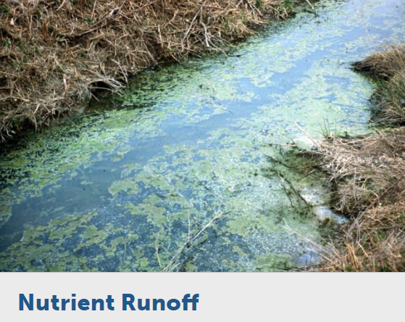
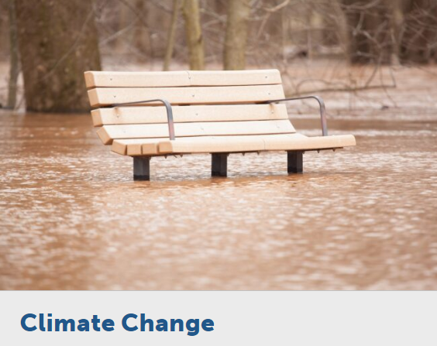
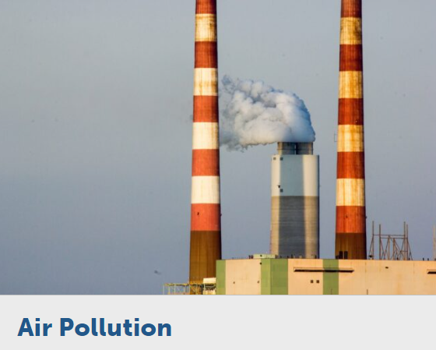
Learn the Issues from
Review the issue cards describing common issues/problems within the Chesapeake Bay Watershed
Using the issue descriptor cards, label each issue based on natural systems, human systems and values. Be prepared to defend your labels.

Slide 4
Learn the Issues from
What issues discussed are relevant to where you work and live?
Are you surprised by any of the issues identified?
Are there any major issues missing that are relevant to your community?
How else would you have students research locally relevant issues?

Slide 5
Activity 2
Connecting Issues with Questions and Standards

Slide 6
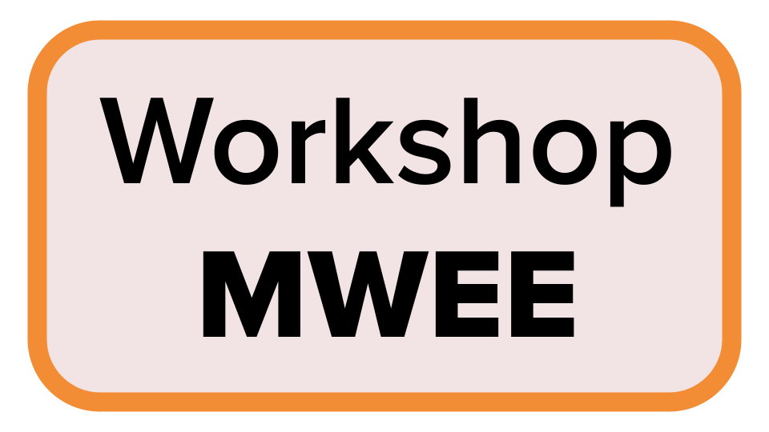
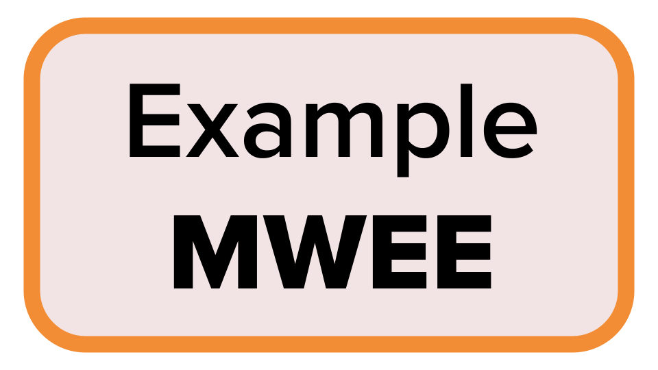
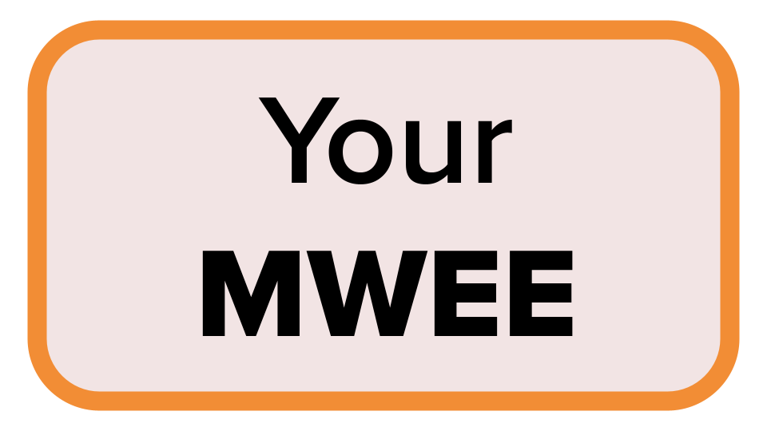
SIDE NOTE - Workshop logistics
Throughout this workshop, to build understanding and confidence around MWEEs we will….
Provide time for participants to develop their own MWEE or fine-tune an existing MWEE
Model a shared
Workshop MWEE
Reference an Example MWEE from ShoreRivers

Slide 7
Issue Investigation
Break into small groups and investigate [the CBP Issue you selected for this workshop - keep it locally relevant]
In your groups discuss…
Why is this issue important and how does it impact the health of the Chesapeake Bay and the watershed?
How might this issue connect to your teaching standards? Where does it fit into the scope and sequence? The existing curriculum? Are there opportunities for interdisciplinary learning (social studies, language arts, math, art, reading)?
Does this issue provide an actionable opportunity for students? How can students help advance some of the solutions that you explored on the issue page?
Let’s go outside!

Slide 8
Driving Question
How do my actions play a role in our changing climate?
Standards/Learning Objectives/Curriculum

Slide 9
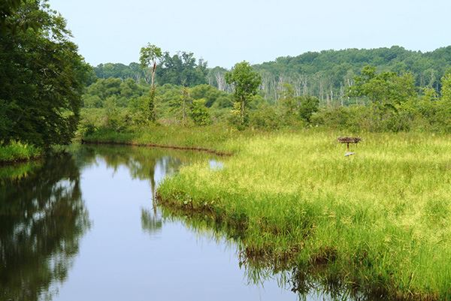

Slide 10
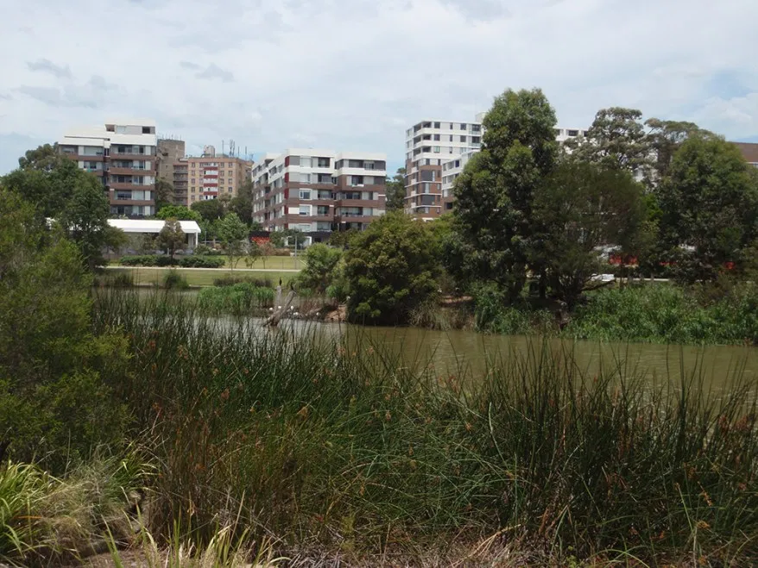

Slide 11
Driving Question - Refined
How does our school’s energy use impact our local tidal wetlands?

Slide 12
How does our school’s energy use impact our local tidal wetlands?
Supporting Questions

Slide 13
Supporting Questions
Brainstorming
[Insert Workshop Driving Question]

Slide 14
Supporting questions
How does our school’s energy use impact our local tidal wetlands?
What is our energy use?
Why does it matter?
How do we measure it?
Where are our wetlands?
Why do they matter?
What is happening to them?

Slide 15
How did your perceptions of the local issue/phenomena change after you went outside?
How do you see this difference benefiting your students?

Slide 16
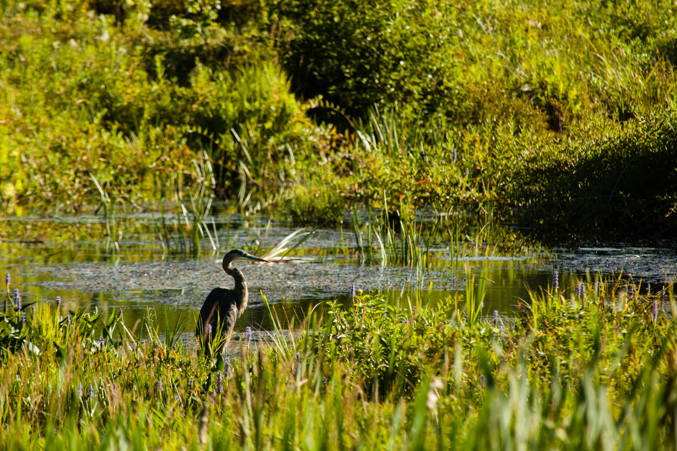
The Outside: Has both Answers and Questions

Slide 17
Activity 3
Introducing Action Early

Slide 18
When have you been involved in environmental or social action?
How did you get involved? What did it mean to you then? Now?

Slide 19
How to achieve meaningful action
Factors influencing individual choices and actions
Perceived locus of control for affecting change
Degree of lasting impact on an individual’s stewardship behaviors
What are the benefits to engaging students in action?
What are some successes and challenges to engaging students in action?

Slide 20
Activity 4
Introducing the MWEE Planning Tools

Slide 21
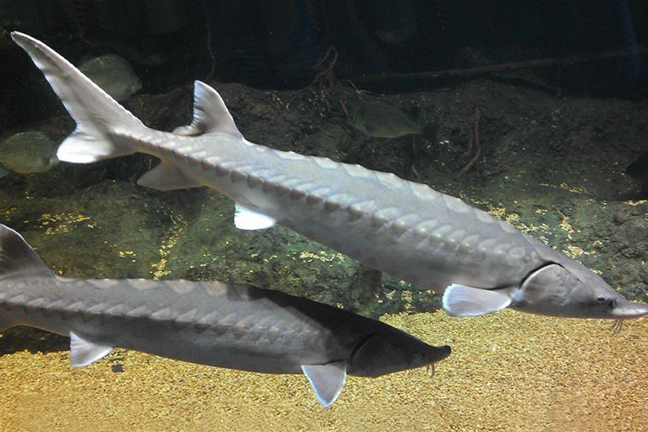
ShoreRivers + Dorchester & Talbot County 3rd Grade
How does this MWEE provide opportunities to explore the impacts of a local environmental issue?
Which characteristics of an effective driving questions are embodied in this example? (p. 8 MWEE Guide)
How are core ideas and practices of multiple disciplines defined and integrated into the MWEE?
Could exploration of this issue logically culminate in stewardship and/or civic action?

Slide 22
Activity 5
Plan it!

Slide 23
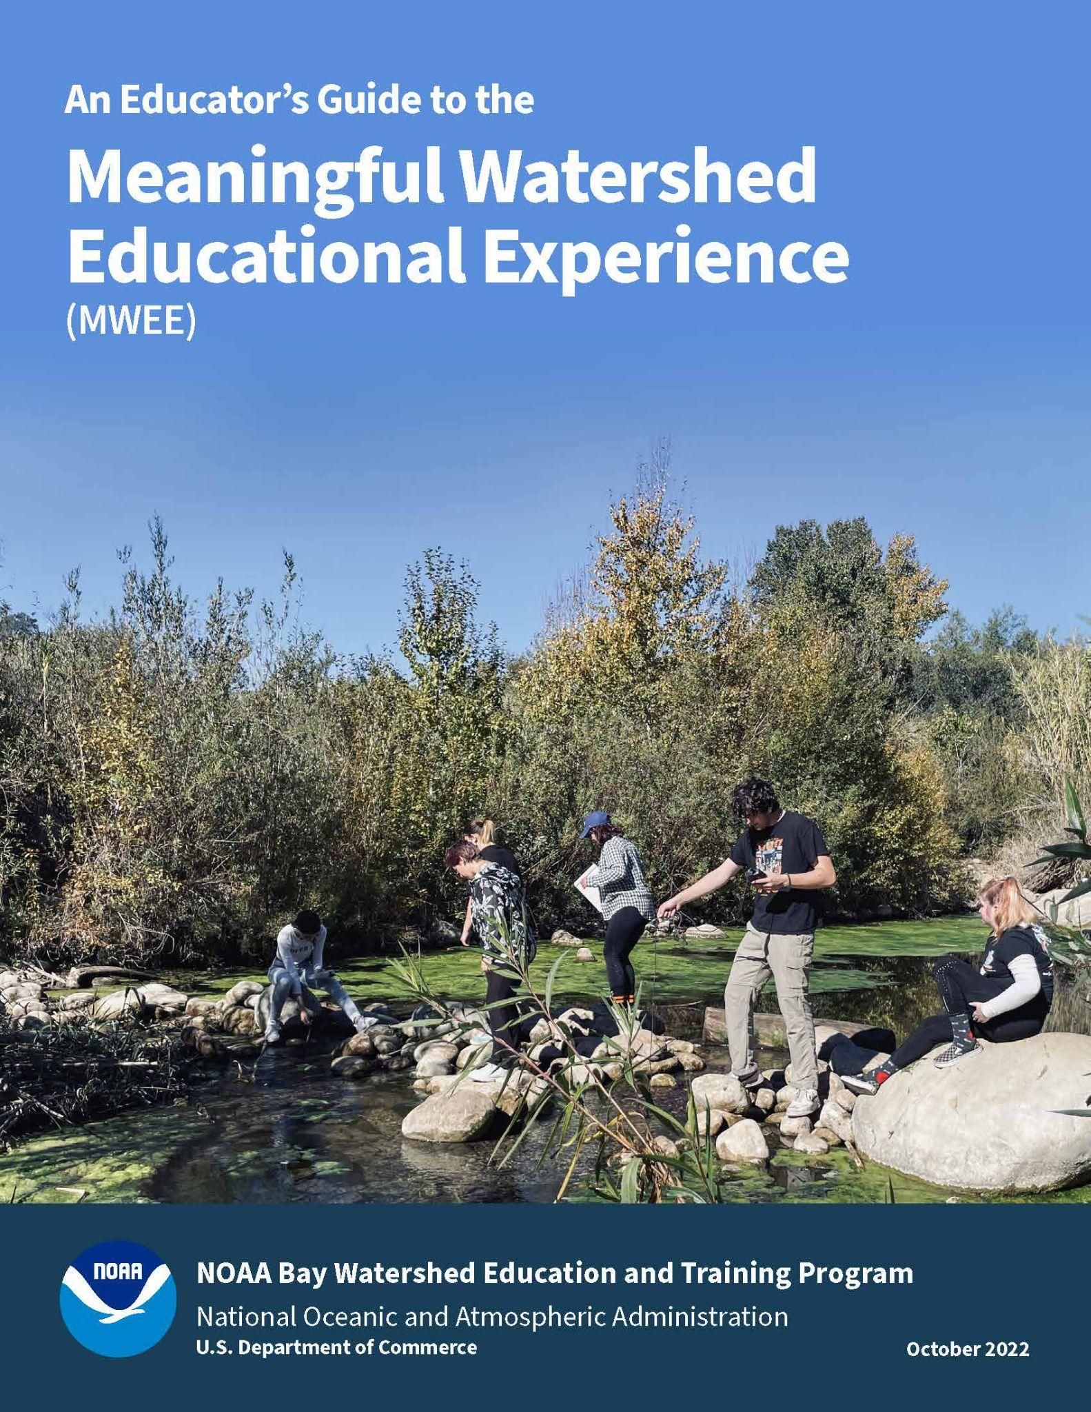
Start planning your MWEE!
Complete the Curriculum Anchor section (page 23) of the Environmental Literacy Model (ELM)
Reference the MWEE Audit Tool (pages 37-54) for additional guidance
Use each other to bounce off ideas!

Slide 24
Additional Resources

Slide 25
Policies and Practices
Public Policy | Private Policy | Community Practice
Written by the government (federal, state, tribal, or local) | Created by businesses, organizations, or other established groups | The habits and behaviors of people

Slide 26
Defining the policies and practices that impact your MWEE issue may take time.
How do you see this step benefitting your students?

