Slide 1
PART 2:
Curriculum Anchor
Activity 2.1 • Exploring Local Issues
Activity 2.2 • Connecting Issues with Questions & Standards
Activity 2.3 • Introducing Early Action
Activity 2.4 • MWEE Planning Tools
Activity 2.5 • Plan It
Notes:
Page 21

Slide 2
Activity 2.1
Exploring Local Issues
Notes:
Page 10

Slide 3

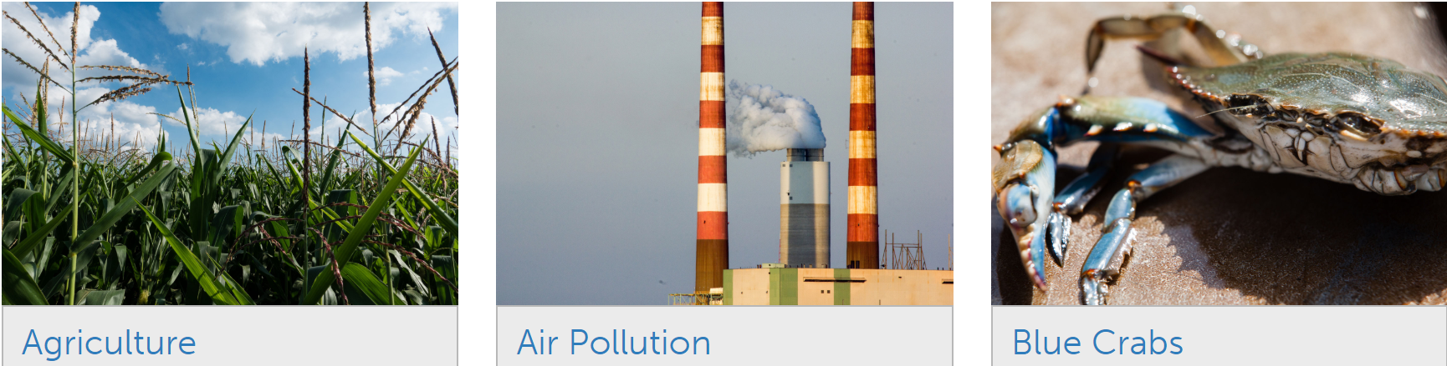
Learn the Issues from
Review the issue cards describing common issues/problems within the Chesapeake Bay Watershed
Using the issue descriptor cards, label each issue based on natural systems, human systems and values. Be prepared to defend your labels.
Notes:
Page 22 - 23

Slide 4
Learn the Issues from
What issues discussed are relevant to where you work and live?
Are you surprised by any of the issues identified?
Are there any major issues missing that are relevant to your community?
How else would you have students research locally relevant issues?
Notes:
Page 22 - 23

Slide 5


Why is it important for students to understand the policies and practices that underpin the issue they are investigate?
Notes:
Page 25

Slide 6
Activity 2.2
Connecting Issues with Questions & Standards
Notes:
Page 10

Slide 7
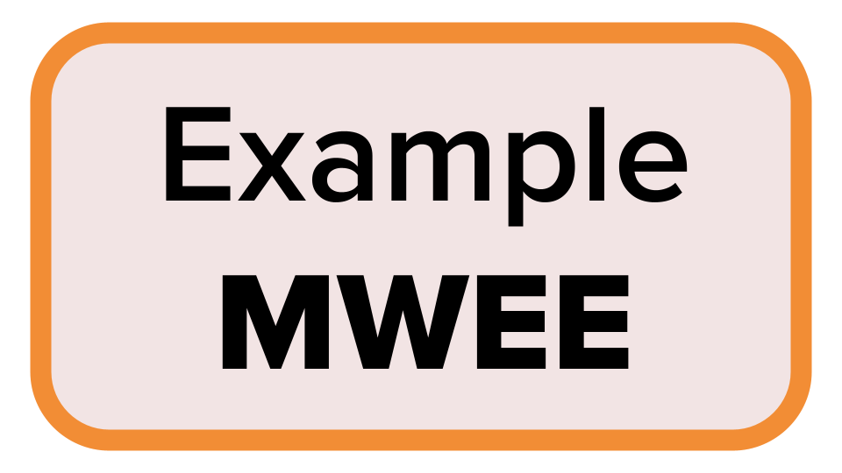

SIDE NOTE - Workshop logistics
Throughout this workshop, to build understanding and confidence around MWEEs we will….
Model a shared
Workshop MWEE
Reference an Example MWEE
Provide time for participants to develop their own MWEE or fine-tune an existing MWEE
Notes:
Page?

Slide 8
Issue Investigation
Break into small groups and investigate one of the issues. In your groups discuss…
  Why is this issue important and how does it affect the health of the Chesapeake Bay and the watershed?
  How might this issue connect to your teaching standards? Where does it fit into the scope and sequence? The existing curriculum? Are there opportunities for interdisciplinary learning (social studies, language arts, math, art, reading)?
  Does this issue provide an actionable opportunity for students? How can students help advance some of the solutions that you explored on the issue page.
Notes:
Page 24 - 25

Slide 9
Issue Investigation continued…
Let’s go outside!
Notes:
Page 24 - 25

Slide 10
How did your perceptions of the local issue/phenomena change after you went outside?
_____________________
How do you see this difference benefiting your students?
Notes:
Page 25

Slide 11
Driving Question
How do our schools actions impact the environment?
Standards/Learning Objectives/Curriculum

Slide 12
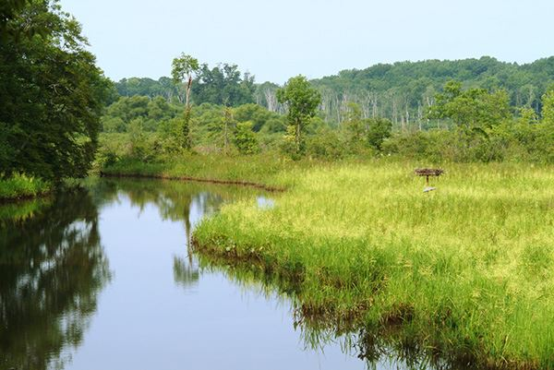

Slide 13
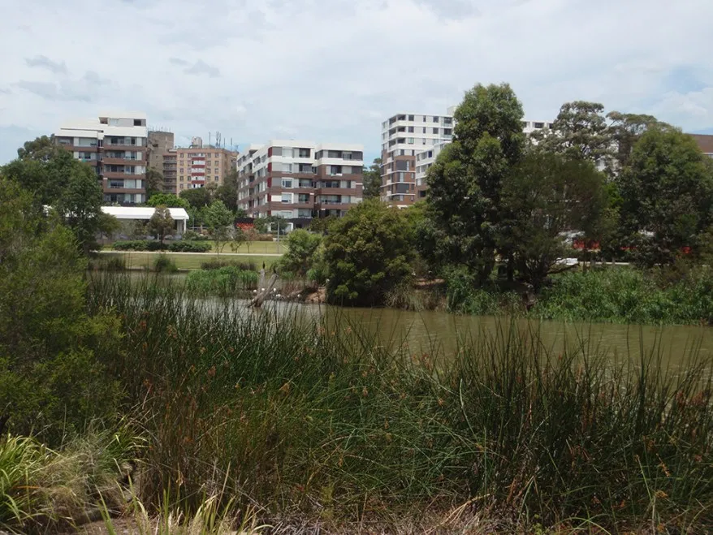

Slide 14
Supporting Questions
Brainstorming
How does litter and trash in our school yard impact our local environment?

Slide 15
Dicussion
What standards/learning objectives can be addressed with these supporting questions?
What sort of investigations might you do to answer these questions?
Which questions are best explored indoors? Which are best explored outdoors?

Slide 16
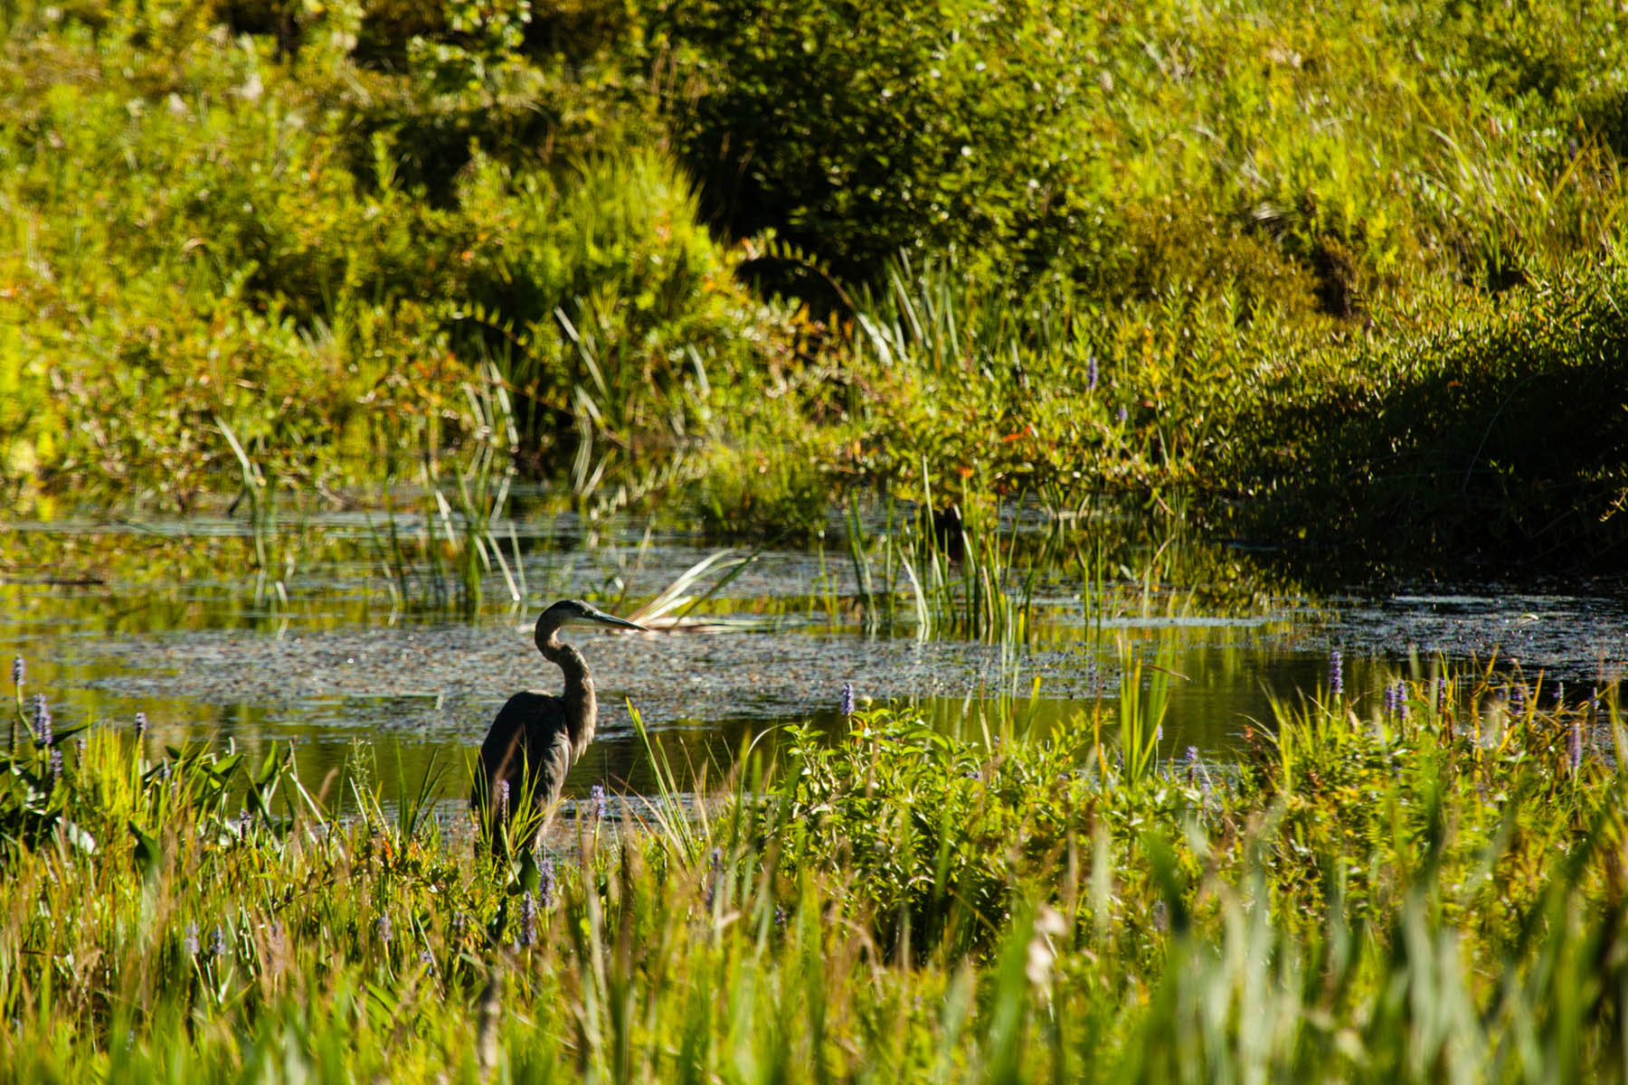
The Outside: Has both Answers and Questions

Slide 17
Activity 2.3
Introducing Early Action
Notes:
Page 10

Slide 18
When have you been involved in environmental or social action?
_____________________
How did you get involved? What did it mean to you then? Now?

Slide 19
How to achieve meaningful action
Factors influencing individual choices and actions
Perceived locus of control for affecting change
Degree of lasting impact on an individual’s stewardship behaviors
What are the benefits to engaging students in action?
What are some successes and challenges to engaging students in action?
Notes:
Page 28

Slide 20
Activity 2.4
MWEE Planning Tools
Notes:
Page 10

Slide 21
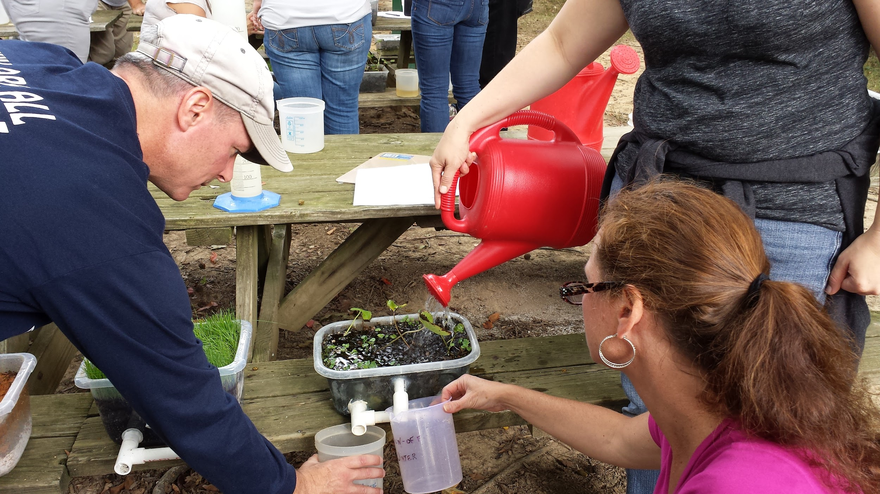
Case Study: FCPS + Blandy
How does this MWEE provide opportunities to explore the impacts of a local environmental issue?
Which characteristics of an effective driving questions are embodied in this example? (p. 28 MWEE Guide)
How are core ideas and practices of multiple disciplines defined and integrated into the MWEE?
Could exploration of this issue logically culminate in stewardship and/or civic action?
Notes:
Page 30 - 31

Slide 22
Activity 2.5
Plan It
Notes:
Page 10

Slide 23
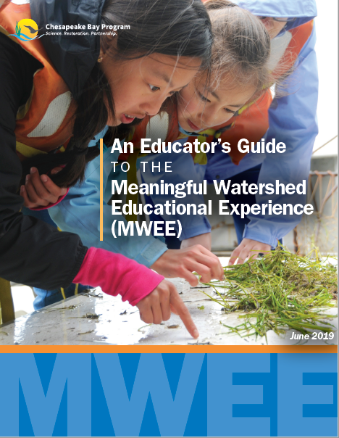
Start planning your MWEE!
Complete the Developing and Supporting Questions worksheet (page 18)
Complete the Curriculum Anchor section (page 23) of the Environmental Literacy Model (ELM)
Reference the MWEE Audit Tool (pages 27-35) for additional guidance
Use each other to bounce off ideas!
Notes:
Page 32

Slide 24
Additional Resources
Notes:
Dave C – DO YOU WANT THIS?

Slide 25

Policies and Practices
Public Policy | Private Policy | Community Practice
Written by the government (federal, state, tribal, or local) | Created by businesses, organizations, or other established groups | The habits and behaviors of people
Notes:
DAVE C – DO YOU WANT THIS?

Slide 26
Why is it important for students to understand the policies and practices that underpin the issue they are investigating?

Slide 27
PART 2: Output & Deliverables
Activity 2.1
Participants will create a conceptual diagram illustrating the connections between Chesapeake Bay Issues and systems, both human and natural.
Activity 2.2
Participants practice identifying issues in a place (schoolyard, park, or location of workshop)
Participants will investigate an issue and develop supporting questions that will guide the inquiry for this workshop which will serve as a model for what MWEEs can look like in their given classes/programs.
Activity 2.3
Participants develop a collective understanding of some of the motivators behind action.
Participants acknowledge their own experience engaging in action and can identify how those experiences line up with aspects of MWEE.
Activity 2.4
Participants will become familiar with the ELM, the worksheets in the MWEE Student Worksheet Toolbox, and the MWEE Audit Tool.
Activity 2.5
Participants will complete the Curriculum Anchor page of the ELM.
Notes:
Page 14 - 15

