Slide 1
Framing the MWEE
Virginia Policies and Education Standards

Slide 2
Activity 1
Reflecting on MWEE 101 Online Course

Slide 3
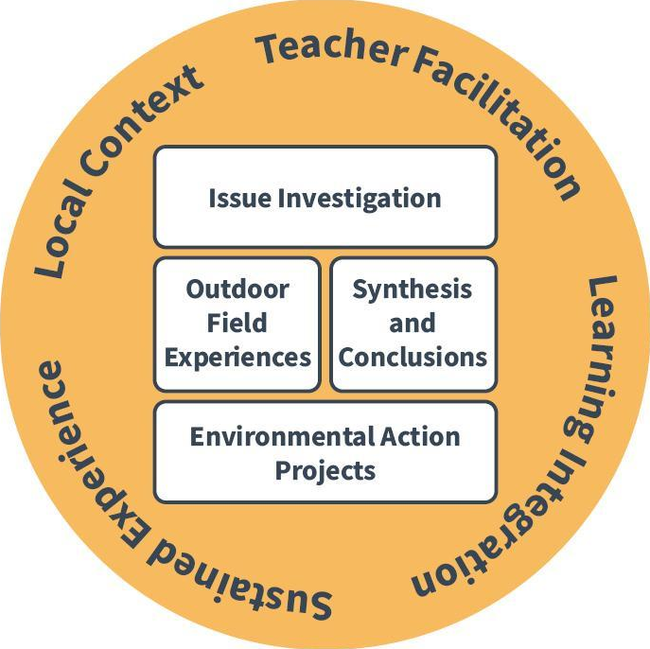
Essential
Elements
&
Supporting Practices

Slide 4
What are the core elements (policies, standards, efforts, etc.) that guide the way you approach teaching environmental literacy in Virginia?
Activity 2

Slide 5
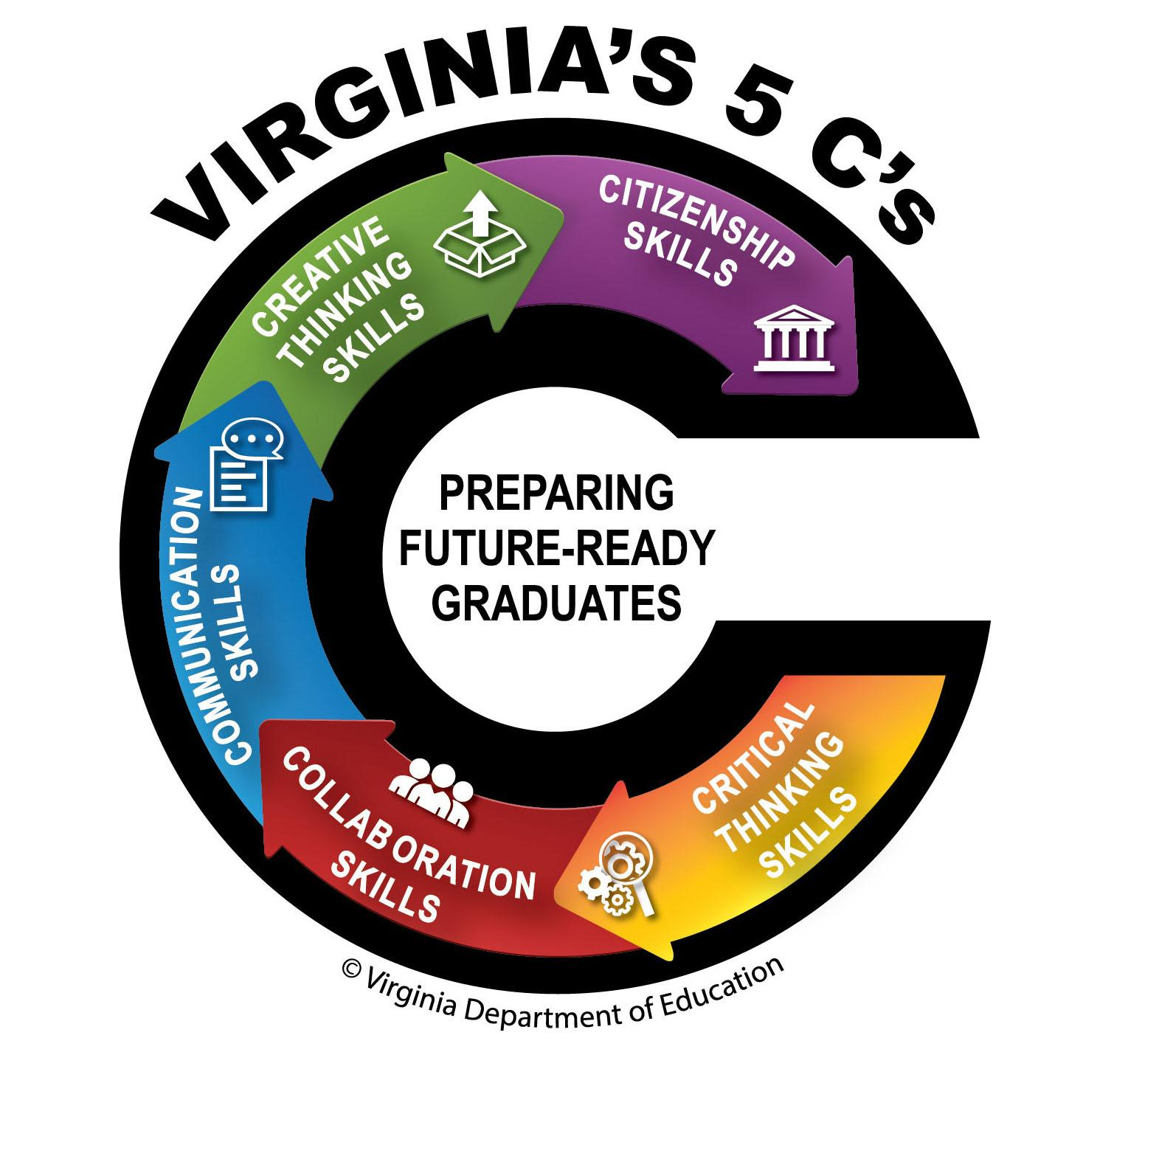
Three Key Drivers in Virginia
VA State Standards

Slide 6
How can MWEEs help to meet multiple state policies and standards?

Slide 7
Environmental Literacy Plans
[Copy or link your district’s Environmental Literacy Plan here or use the examples pasted on the following slides]

Slide 8
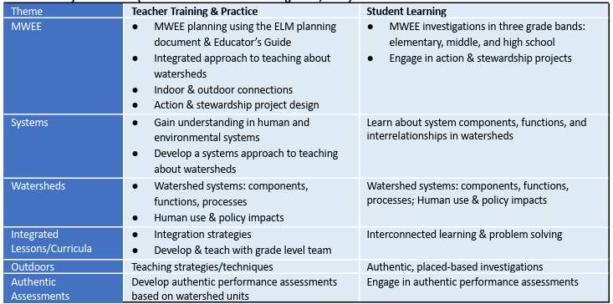
Environmental Literacy
Plan
Clarke County Public Schools

Slide 9
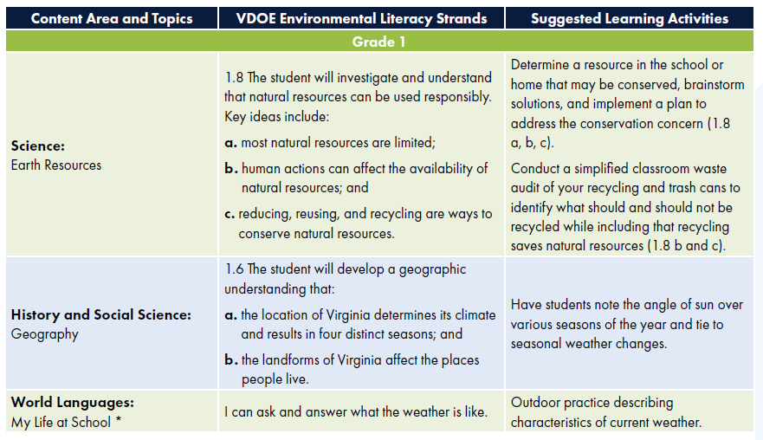
Environmental Literacy
Plan
Prince William County Public Schools

Slide 10
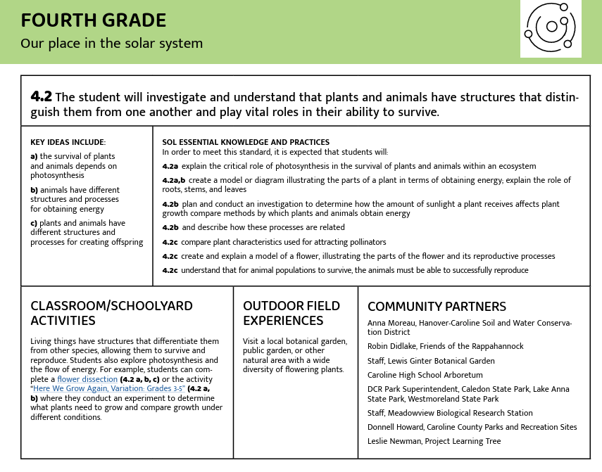
Environmental Literacy
Plan
Caroline County Public Schools

Slide 11
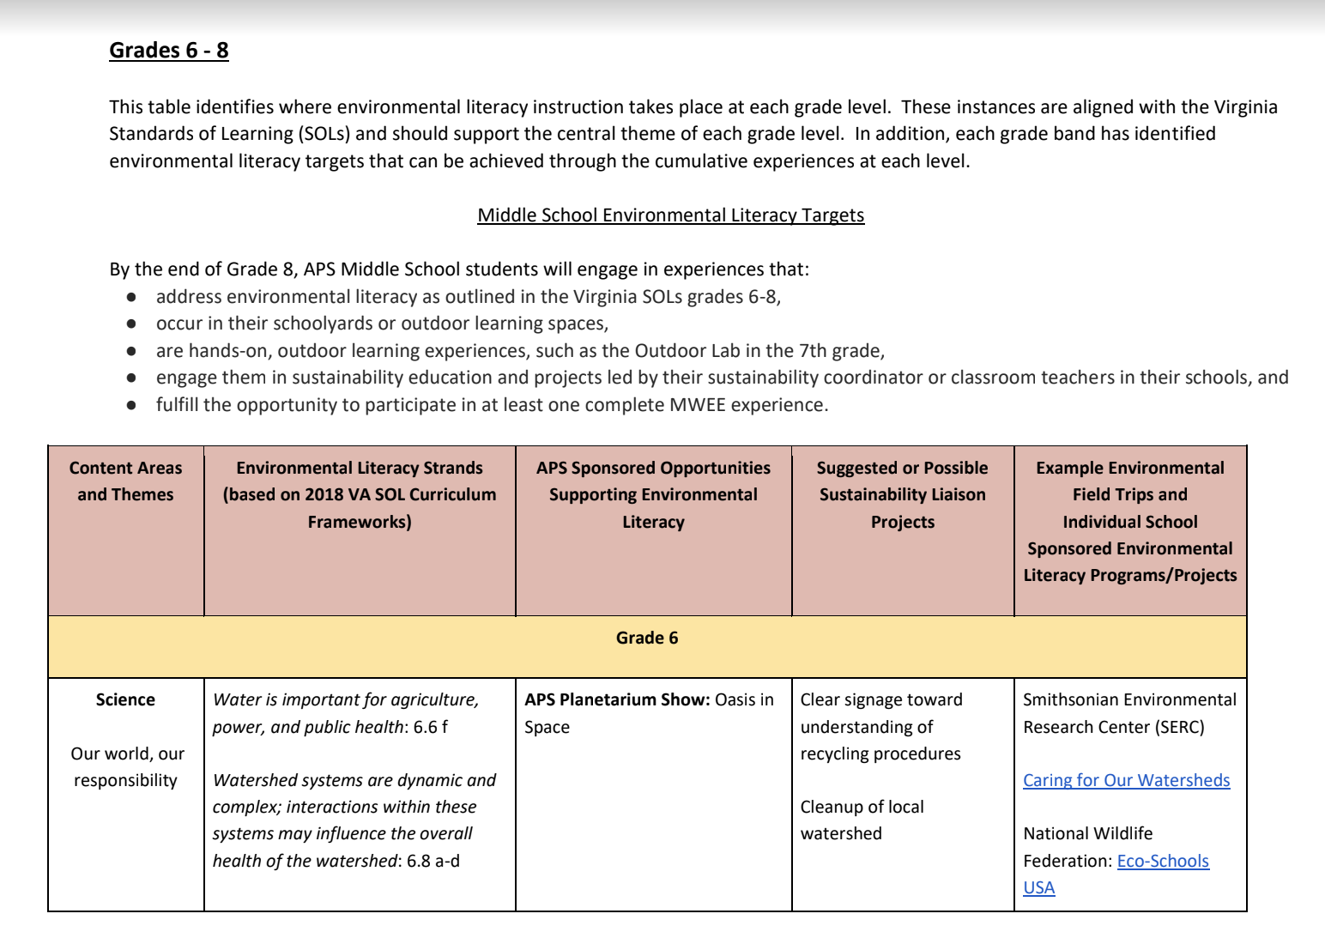
Environmental Literacy
Plan
Arlington County Public Schools (page 13 of EL Plan)

Slide 12
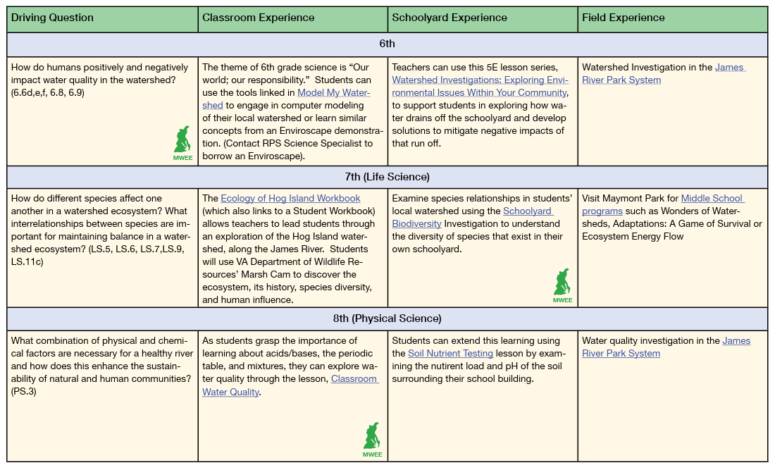
Environmental Literacy
Plan
Richmond Public Schools

Slide 13
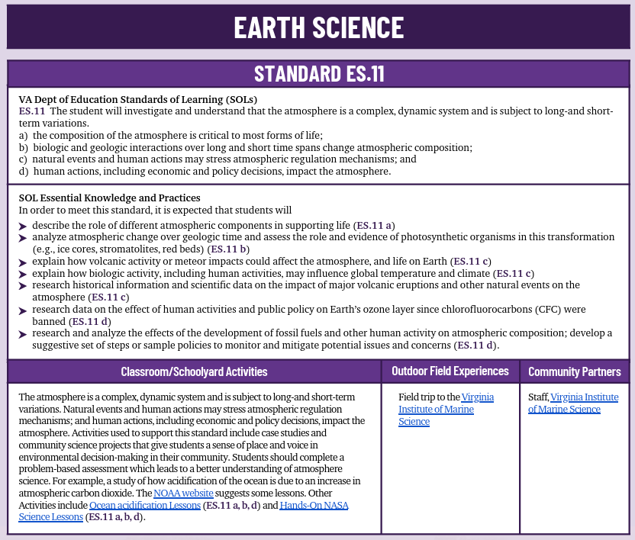
Environmental Literacy
Plan
Essex County Public Schools

Slide 14
Environmental Literacy
Plan
Middlesex County Public Schools

Slide 15
How do you see a district or county-wide Environmental Literacy Plan helping the implementation and continuation of a MWEE?

