Slide 1
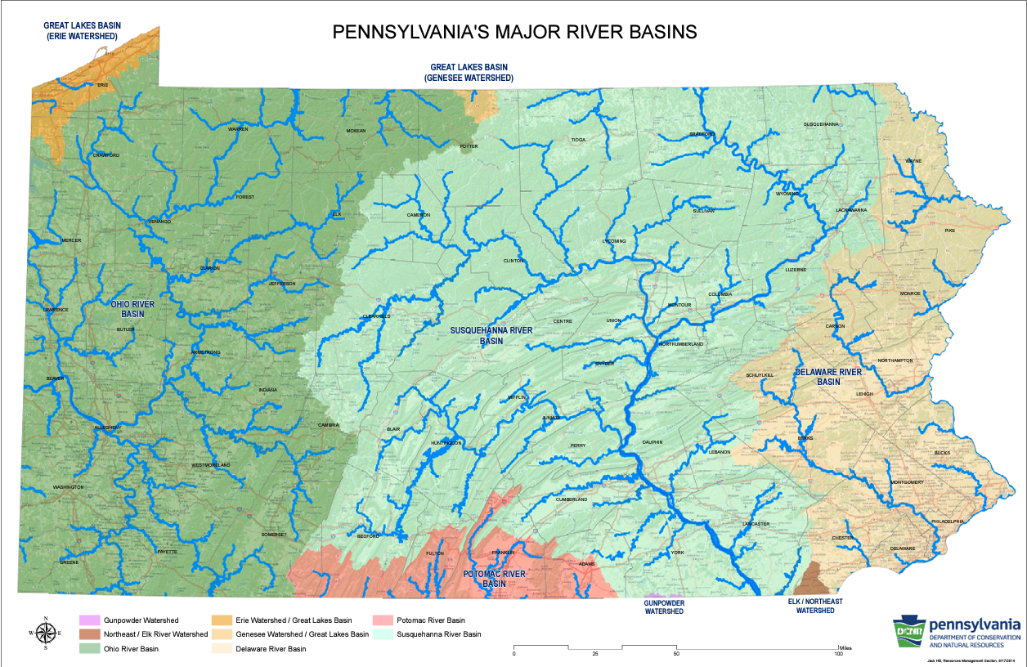
Notes:
Activity 1 Watershed Intro -Virtual option in additional resources at end of slide deck

Slide 2
Framing the MWEE
Pennsylvania Policies and Education Standards
Notes:
PDE Mission:
Ensure that every learner has access to a world-class education system that academically prepares children and adults to succeed as productive citizens.
Establish a culture that is committed to improving opportunities throughout the commonwealth by ensuring that technical support, resources, and optimal learning environments are available for all students, whether children or adults. Using Environment & Ecology context as themes for lesson, unit, and curriculum development.
PA Environmental Education Act (1993, 2007, 2008)
Modeled after National Environmental Education Act (1990)
Chesapeake Bay Watershed Agreement (2015)
PA Advisory Council on Environmental Education
PA Environmental Literacy Plan (2015) in support of ESSA and No Child Left inside act of 2015
Applys the essence of the CBWA to the entire state. PA drainst into not only the CBWA but to the OHio/Mississippi/Gulf of Mexico
PA Academic Standards (EE & Science and Technology)
United Nations Sustainability Goals
Belgrade Charter
Tbilisi Agreement’’Delaware River Basin Commission
International Joint Commission (Great Lakes)

Slide 3
Reflecting on MWEE 101 Online Course
Activity 2
Notes:
Virtual Option 1: Using the slide numbered “1” found in additional resources at the end of this presentation, ask participants to work in small groups to organize the essential elements and supporting practices stickies to illustrate the flow of the MWEE.
Virtual Option 2: In small group ask participants to respond to the prompts found in the slides numbered 2-5 found in the additional resources at the end of this presentation.

Slide 4
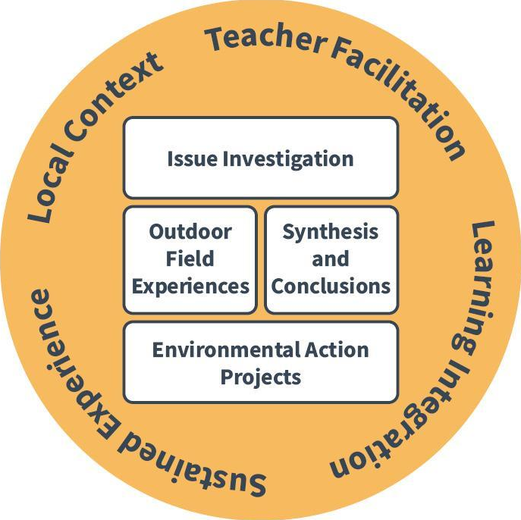
Essential
Elements
&
Supporting Practices
Notes:
Quick questions/reflections on MWEE 101 experience
SUPPORTING PRACTICES = just as we model with you, it continues to teacher and on to students
Not a one hit wonder

Slide 5
What are the core elements (policies, standards, efforts, etc.) that guide the way you approach teaching environmental literacy in Pennsylvania?
Activity 3
Notes:
Chat response

Slide 6
Three Key Pieces: Policy and Programs
Pennsylvania Environmental Education Act
PA Pathways to Green Schools
Notes:
PDE Mission:
Ensure that every learner has access to a world-class education system that academically prepares children and adults to succeed as productive citizens.
Establish a culture that is committed to improving opportunities throughout the commonwealth by ensuring that technical support, resources, and optimal learning environments are available for all students, whether children or adults. Using Environment & Ecology context as themes for lesson, unit, and curriculum development.
PA Environmental Education Act (1993, 2007, 2008)
Modeled after National Environmental Education Act (1990)
Chesapeake Bay Watershed Agreement (2015)
PA Advisory Council on Environmental Education
PA Environmental Literacy Plan (2015) in support of ESSA and No Child Left inside act of 2015
Applies the essence of the CBWA to the entire state. PA drainst into not only the CBWA but to the OHio/Mississippi/Gulf of Mexico
PA Academic Standards (EE & Science and Technology)
United Nations Sustainability Goals
Belgrade Charter
Tbilisi Agreement’’Delaware River Basin Commission
International Joint Commission (Great Lakes)
PA EE Act
https://www.legis.state.pa.us/cfdocs/Legis/LI/uconsCheck.cfm?txtType=PDF&yr=1993&sessInd=0&smthLwInd=0&act=0024.
Defines PA Advisory Council on EE who developed the state level ELIT plan - 2015
https://www.education.pa.gov/Teachers%20-%20Administrators/GreenSchools/Pages/default.aspx
Mission:
Ensure that every learner has access to a world-class education system that academically prepares children and adults to succeed as productive citizens.
Establish a culture that is committed to improving opportunities throughout the commonwealth by ensuring that technical support, resources, and optimal learning environments are available for all students, whether children or adults. Using Environment & Ecology context as themes for lesson, unit, and curriculum development.
PA Environmental Education Act (1993, 2007, 2008)
Modeled after National Environmental Education Act (1990)
Chesapeake Bay Watershed Agreement (2015)
PA Advisory Council on Environmental Education
PA Environmental Literacy Plan (2015) in support of ESSA and No Child Left inside act of 2015
Applys the essence of the CBWA to the entire state. PA drainst into not only the CBWA but to the OHio/Mississippi/Gulf of Mexico
PA Academic Standards (EE & Science and Technology)
United Nations Sustainability Goals
Belgrade Charter
Tbilisi Agreement’’Delaware River Basin Commission
International Joint Commission (Great Lakes)

Slide 7
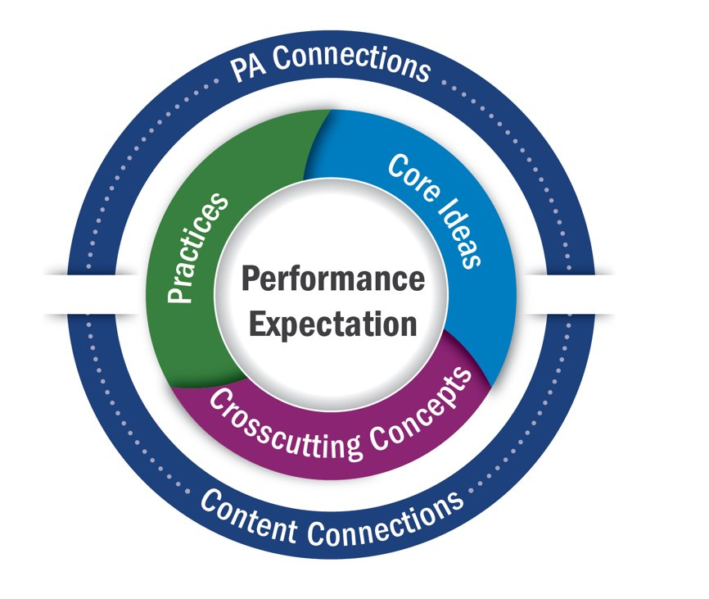
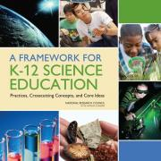
State Education Standards in Pennsylvania
Pennsylvania State Board
of Education
Chapter 4 Regulations
Proposed PA Academic Standards
STEELS Standards
Notes:
MWEE is a framework, process, method for teaching and learning not a curriculum
Chapter 4 Regulations - a minimum benchmark for student understandings during educational career.
Schools must at least achieve but are welcome to aim for higher levels of understanding and process.
3-d Standards modeling/learning is a inquiry/problem/project based way to explore phenomena.
Performance expectations (standards)​
Three-dimensional​
Practices​
Core Ideas​
Crosscutting Concepts​
PA Connections​
Content Connections

Slide 8
How can MWEEs help to meet multiple state policies and standards, while also helping you meet your LEA’s needs?
Notes:
Brainstorm in chat
Curriculum alignment
More active student engagement
21st century skills
EJ
Local Relevance

Slide 9
Environmental Literacy Plans
Activity 4

Slide 10
PA Environmental Literacy Plan
Recommendations | Action Steps Providers
School System - Recommendation 3: Engage students in meaningful outdoor learning experiences to address the PA Academic Standards (Chapter 4). | 1. Incorporate meaningful outdoor learning experiences at the primary, intermediate, middle and high school levels. 2. Utilize environmentally- oriented service learning and citizen science projects throughout the K-12 continuum to solidify student environmental literacy. | 3. Work to encourage environmental related after-school and summer enrichment programs for students. 4. Promote the use of real world environmental concerns in project based learning experiences.
Life Long Learner Recommendation 5 Provide environmental learning opportunities to a diverse population not currently represented in the leadership or decision making. | 1. Engage minority and stakeholder groups so that all stakeholders have equitable access to environmental education. | School districts, higher education, conservation districts, environmental non-profits, governmental agencies, businesses, industries, Penn State Cooperative Extension and/or families
Examines 8 focus areas:
The School System
Life-Long Learners and Civic Engagement
Sustainable Practices, Healthy Living and the Environment
Funding and Implementation
Partnerships
Early Childhood Education
Pre-Service Education
Professional Development
Notes:
PA Elit Plan,
The Governor of Pennsylvania along with eight neighboring governors and federal agencies have re-affirmed the commitment to work cooperatively for the purpose of creating a more environmentally and economically sustainable Chesapeake Bay watershed.
Mid-Atlantic Environmental Literacy Goal and the outcomes, each state is responsible to develop a state-specific environmental literacy plan by collaborating with vital partners representing state agencies, organizations and associations. (Our first was written in 2013, it was re written in 2015, to incorporate aspects of the NO CHild Left in Inside Act 2015. Unfortunately it didn’t get much attention in the formal education world the time because there was no one in my position from April 2012 to January 2019.
Modeled after components of CBWA but integrated NAAEE guidance points as well
Applies to whole state as recommendations designed by interagency PA ACEE and issupported by all partner agencies
LEA Env Lit Plans
Structured around Green Ribbon School Pillars with added pieces
https://www.baybackpack.com/files/PA-Environmental-Literacy-Plan-TEMPLATE.docx

Slide 11
LEA/District Support
Environmental Literacy/Sustainability Plan
Pillar 1: Reduced Environmental Impact | Pillar 2: Positive Impact on Student and Staff Health | Pillar 3: Effective Environmental and Sustainability Education
💡Energy conservation and efficiency 🔌 | 🦠Environmental Health Program ⚠️ | 📖Curriculum (Refer to Appendix A: Environmental Literacy Framework) | 🔗Community Partnerships
💧Improved water quality, efficiency and conservation 🚰 | 🥗Nutrition, Fitness and Outdoor Time ⚽️ | 👩‍🏫Instruction (Refer to Appendix A: Environmental Literacy Framework) | 💵Funding
🗑Reduced waste production, improved recycling and composting programs ♻️ |  | 🧑🏽‍💻Professional Development | 📚Program Sustainability
🛣 Use of alternative transportation to, during and from school 🚌
Note: consider the use of MWEE at each grade level or selective grade levels
Notes:
LEA Env Lit Plans
Refer back to Elit Survey
Structured around Green Ribbon School Pillars with added pieces
https://www.baybackpack.com/files/PA-Environmental-Literacy-Plan-TEMPLATE.docx

Slide 12
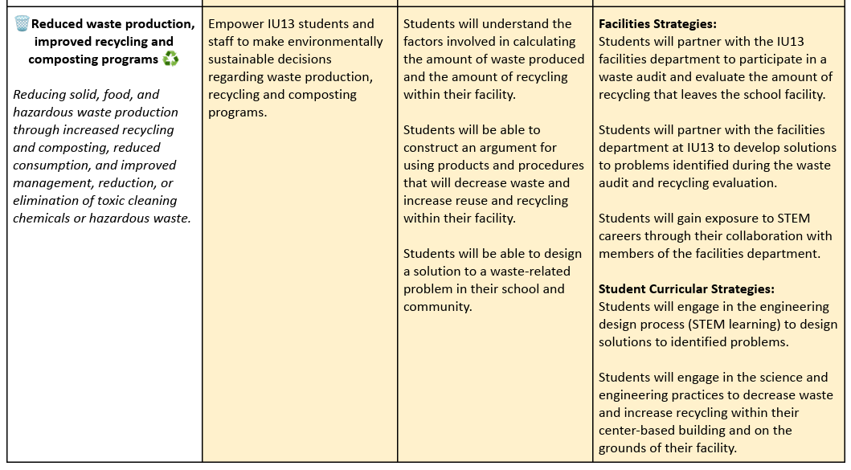
Environmental Literacy
Plan
Lancaster-Lebanon Intermediate Unit 13

Slide 13
How do you see a LEA, IU or school level Environmental Literacy & Sustainability Plan helping the implementation and continuation of a MWEE?

Slide 14
Additional Resources

Slide 15
Name
Name
Name
Name
Name
Name
Name
Name
Name
Name
Name
Name
Name
Name
Notes:
Watershed Introduction - virtual option - Invite participants to move one of the yellow text boxes to where they live or work and add their name to the box.

Slide 16
Issue Definition
Outdoor Field Experience
Environmental Action Project
Synthesis and Conclusions
Learning Integration
Teacher Facilitation
Local Context
Sustained Experience
1

Slide 17
What might this element look like practically in your practice (classroom/program)?
What makes this essential element the most important?
Environmental Action Project
MWEE Guide (p.9-10)
Students brainstorm and evaluated solutions to the issue and then take action! Action comes in many forms but it should be student-driven.
Why is this an essential element?
2

Slide 18
What might this element look like practically in your practice (classroom/program)?
What makes this essential element the most important?
Outdoor Field Experiences
MWEE Guide (p.9)
Students participate in multiple outdoor field experiences sufficient to investigate the issue. This may include collecting data or making observations. They may occur on school grounds or at an off-site location.
Why is this an essential element?
3

Slide 19
What might this element look like practically in your practice (classroom/program)?
What makes this essential element the most important?
Issue Definition
MWEE Guide (p.7)
Students focus on an environmental question, problem, or issue requiring background research and investigation.
Why is this an essential element?
4

Slide 20
What might this element look like practically in your practice (classroom/program)?
What makes this essential element the most important?
Synthesis and Conclusions
MWEE Guide (p.9)
Students identify, synthesis, and apply evidence from their investigations to draw conclusions and make actionable claims about the issue.
Why is this an essential element?
5

