Slide 1
PART 1: Framing the MWEE
Activity 1.1 • Reflection on MWEE 101 Online Course
Activity 1.2 • State Policies & State Education Standards
Activity 1.3 • Environmental Literacy Plans
Notes:
Page 9

Slide 2
Activity 1.1
Reflecting on MWEE 101 Online Course
Notes:
Page 10

Slide 3
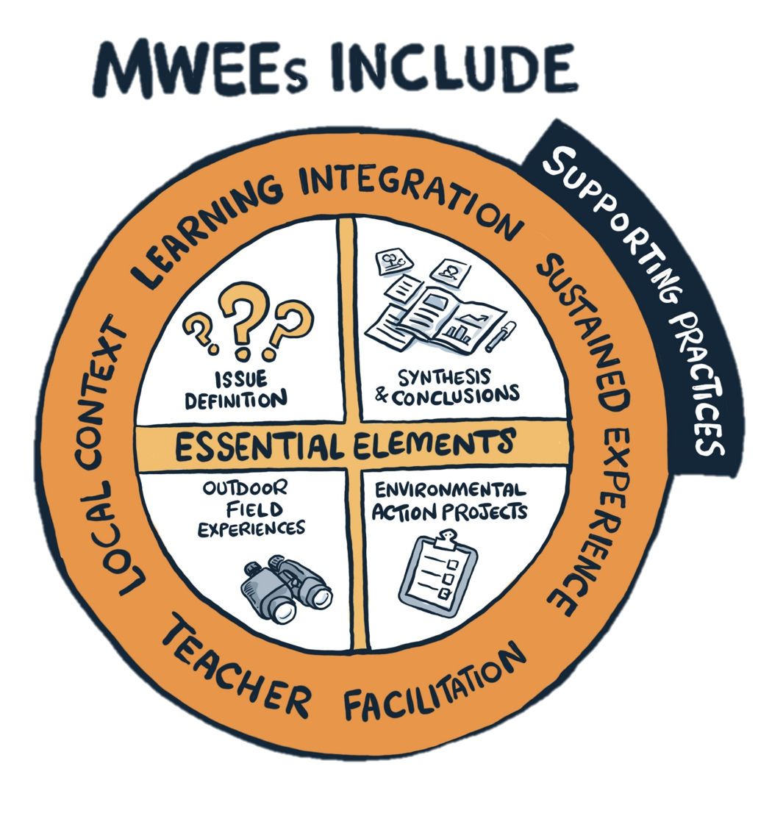
Essential
Elements
&
Supporting Practices
Notes:
Page 10

Slide 4
Activity 1.2
State Policies & State Education Standards
Notes:
Page 10

Slide 5






Key Drivers in Delaware
Delaware Environmental Literacy Plan
Portrait of an Environmentally Literate Citizen
Delaware State Standards
Notes:
Page 11

Slide 6

Chesapeake Bay Watershed Agreement:
Environmental Literacy Goal
Student
Continually increase students’ age-appropriate understanding of the watershed through participation in teacher-supported, meaningful watershed educational experiences and rigorous, inquiry-based instruction, with a target of at least one meaningful watershed educational experience in elementary, middle and high school depending on available resources.
2. Sustainable Schools
Continually increase the number of schools in the region that reduce the impact of their buildings and grounds on their local watershed, environment and human health through best practices, including student-led protection and restoration projects.
3. Environmental Literacy Planning
Each participating Bay jurisdiction should develop a comprehensive and systemic approach to environmental literacy for all students in the region that includes policies, practices and voluntary metrics that support the environmental literacy Goals and Outcomes of this Agreement.
https://www.chesapeakebay.net/what/goals/environmental_literacy
Notes:
Page 11

Slide 7
Delaware Environmental Literacy Plan
Adopted in 2015, the Delaware Environmental Literacy Plan address three major issues:
Define meaningful outdoor experiences for students, children, families, and community members.
Define the need for an environmentally literate community in Delaware
Establish goals for environmental literacy at home, work, school, and at leisure.
Notes:
Page 12 - 13

Slide 8
The plan recommends two specific goals for Schools
GOAL #1 | Action Steps
Integrate environmental education, Next-Generation Science Standards, Common Core, and Delaware Social Studies Standards. | 1.A Identify where environmental education already exists within these standards. 1.B Identify ways environmental education can be integrated more effectively across the curriculum. | 1.C Provide meaningful outdoor experiences for students that: Occur at least once in each grade ban (K-2, 3-5, 6-8, 9-12) Promote Delaware’s unique history, culture, environment, economy, literature, and/or art. Engage practice-based, investigative or project-oriented activities in the natural environment. Develop sustainable experiences that continue through students’ academic careers. Enhance the experience with natural resource personnel to add expertise and promote career opportunities.
Notes:
Page 12 - 13

Slide 9
The plan recommends two specific goals for Schools
GOAL #2 | Action Steps
Delaware schools and their grounds serve as community models for green landscape design, operation and energy efficiency and/or environmentally aware practices | 2.A All schools are enrolled either in the Federal Green Schools Program or the Pathways to Green Schools Program | 2.B Each school will choose a “Green” focus to increase environmental literacy: Option 1 – Schoolyard Habitat Option 2 – School Garden Option 3 – NATURE STEM School (NATURE STEM projects conducted during each grade level )
Notes:
Page 12 - 13

Slide 10
Portrait of an Environmentally Literate Citizen
Access to rigorous course of study
Participated in authentic inquiry-based learning
Involved in environmental stewardship
Prepared for success
Understand environmental processes & systems
Understand local, regional, & global environmental issues
Aware of careers in the environmental field
Analyze local & global environmental issues
Make responsible decisions
Notes:
Page 13 - 14

Slide 11
Delaware State Education Mission, Vision, and Priorities
Vision Every learner ready for success in college, career and life
Mission To empower every learner with the highest quality education through shared leadership, innovative practices and exemplary service
Priorities
Engaged and informed families, schools, districts, communities, and other agencies
Rigorous standards, instruction, and assessments
High quality early learning opportunities
Equitable access to excellent educators
Safe and healthy environments conducive to learning
https://education.delaware.gov/about-doe/vision/
Notes:
Page 14 - 15

Slide 12
State Education Standards in Delaware
Next Generation Science Standards (NGSS)
Delaware Social Studies Standards
The Science Standards of Learning
Environmental Literacy and CTE in Delaware
https://education.delaware.gov/about-doe/vision/
Notes:
Page 14 - 15

Slide 13

What are the core elements (policies, standards, efforts, etc.) that guide the way you approach teaching environmental literacy in Delaware?
Notes:
Page 18

Slide 14
How can MWEEs help to meet multiple state policies and standards?

Slide 15
Activity 1.3
Environmental Literacy Plans
Notes:
Page 10

Slide 16
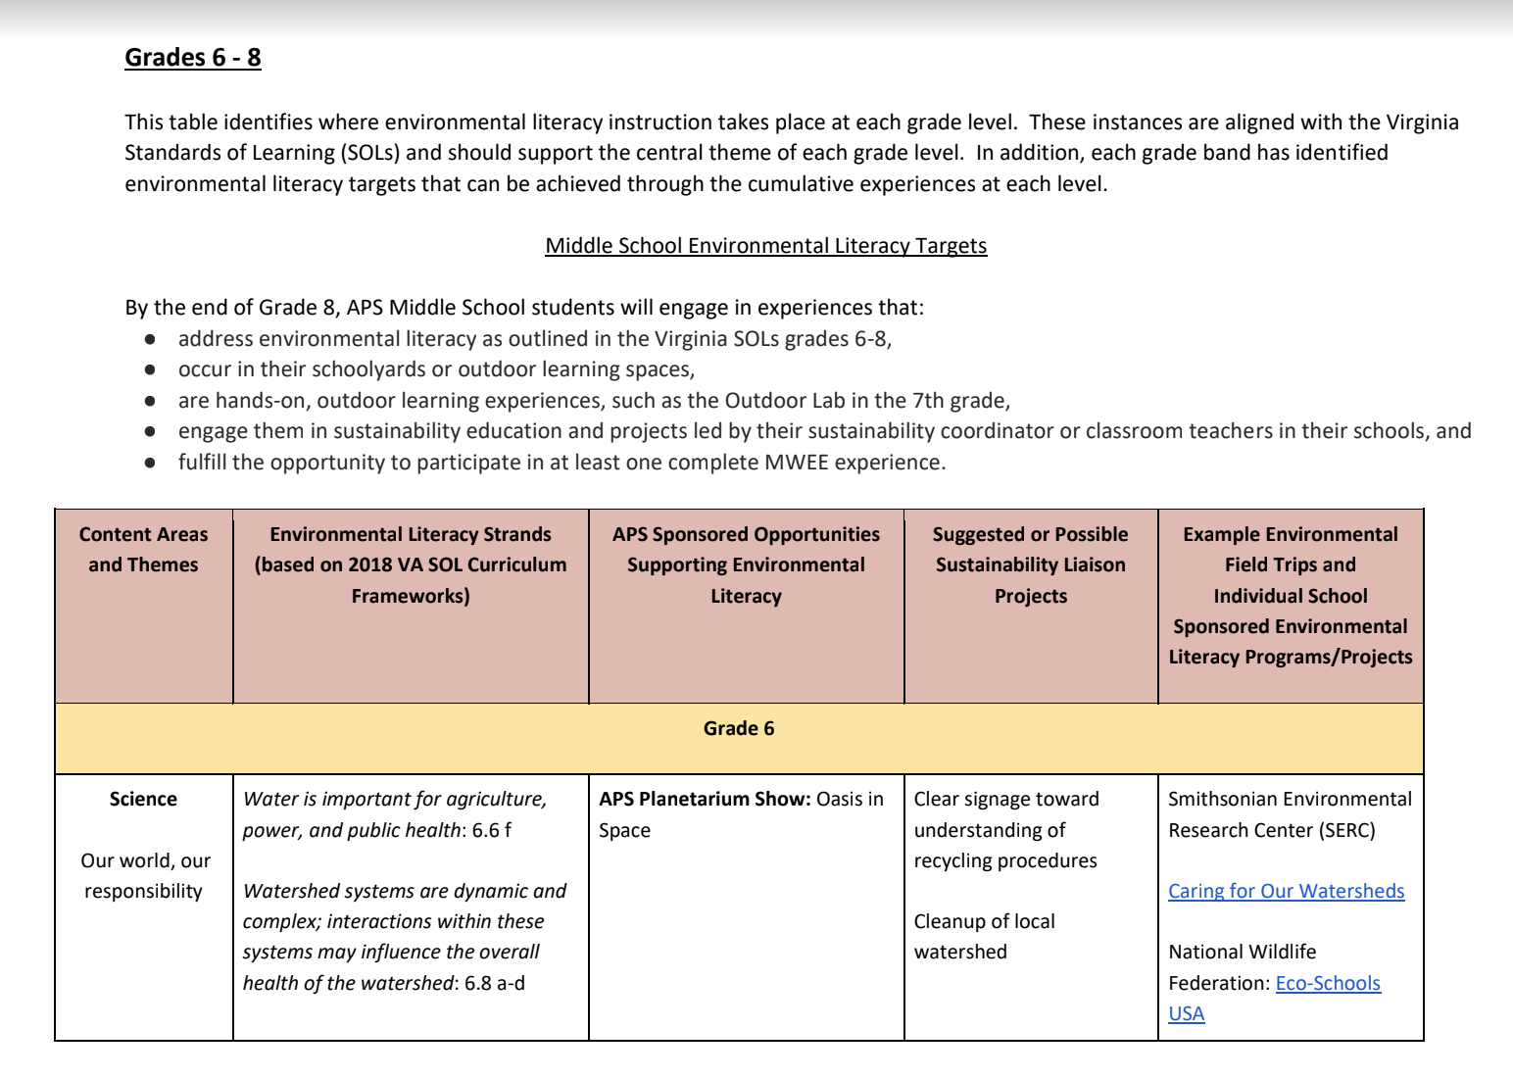
Environmental Literacy
Plan
Example:
Arlington County Public Schools (page 13 of EL Plan)
Notes:
Page 19 (Not in Guide) – Should this be in the guide????

Slide 17
How do you see a division or county-wide Environmental Literacy Plan helping the implementation and continuation of a MWEE?
Notes:
Page 19

Slide 18
PART 1: Output & Deliverables
Activity 1.1
Participants will recall their knowledge and understanding of the MWEE essential elements and supporting practices and how they work together to create a comprehensive learning experience for students.
Activity 1.2
Participants will review Delaware State policies and education standards and discuss how they will support MWEEs.
Activity 1.3
Participants will examine a division-wide Environmental Literacy Plan and discuss how one of these plans could support the implementation and continuation of a MWEE.
Notes:
Page 14 - 15

