Slide 1
Framing the MWEE
[Your State’s] Policies and Education Standards

Slide 2
Activity 1
Reflecting on MWEE 101 Online Course

Slide 3
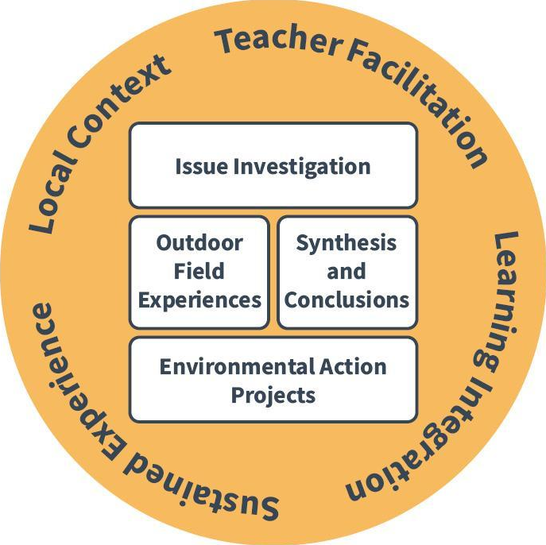
Essential
Elements
&
Supporting Practices

Slide 4
What are the core elements (policies, standards, efforts, etc.) that guide the way you approach teaching environmental literacy in [your state]?
Activity 2

Slide 5
Key Pieces of Policy
[List state policies and initiatives that support environmental literacy]

Slide 6
State Education Standards supporting MWEEs
[List state education standards that support MWEEs - make sure to include a review of all the standards your participants may be working with]

Slide 7
How can MWEEs help to meet multiple state policies and standards?

Slide 8
Environmental Literacy Plans
[Copy or link your district’s Environmental Literacy Plan here or use the examples pasted on the following slides]

Slide 9
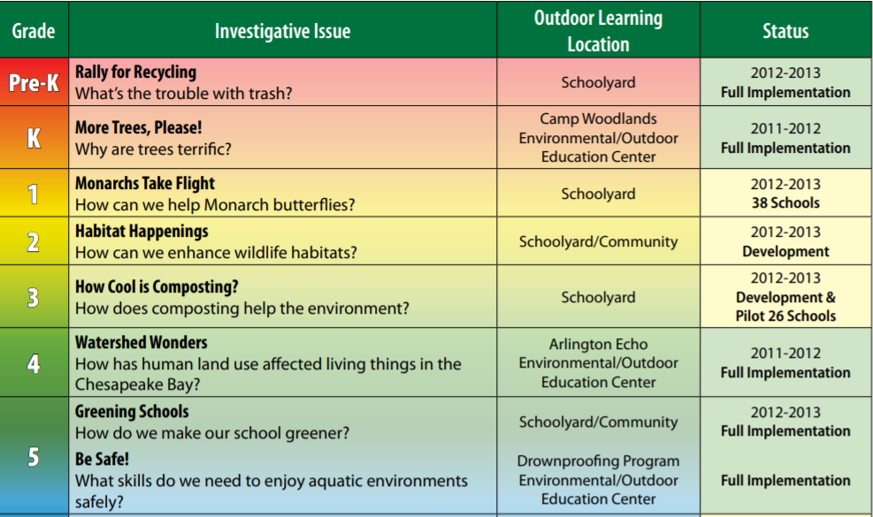
Environmental Literacy
Plan
Anne Arundel County Public Schools
Elementary School

Slide 10
Environmental Literacy
Plan
Anne Arundel County Public Schools
Middle School

Slide 11
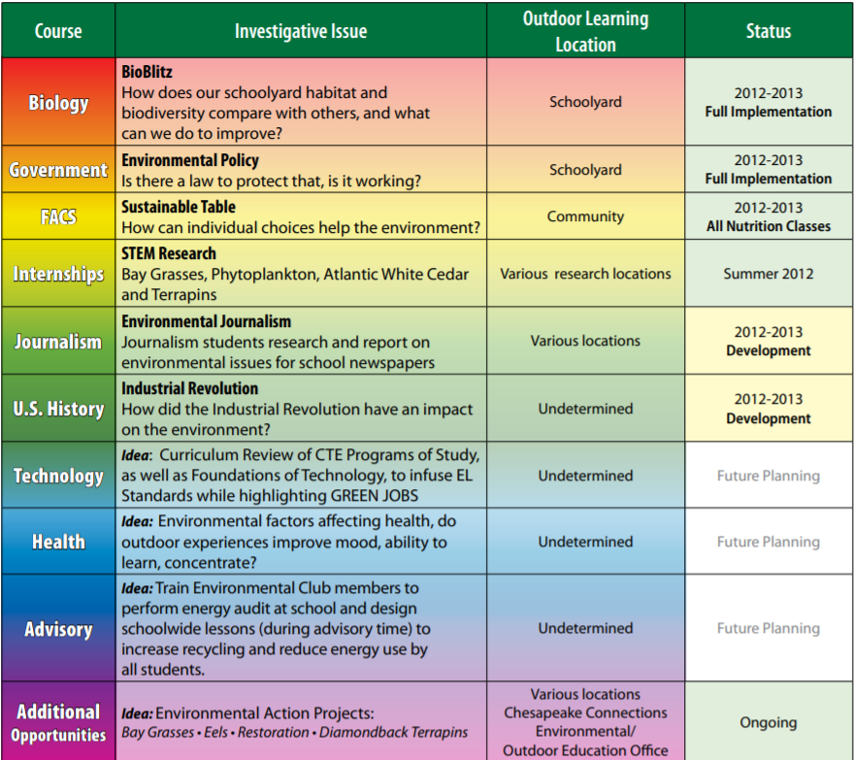
Environmental Literacy
Plan
Anne Arundel County Public Schools
High School

Slide 12
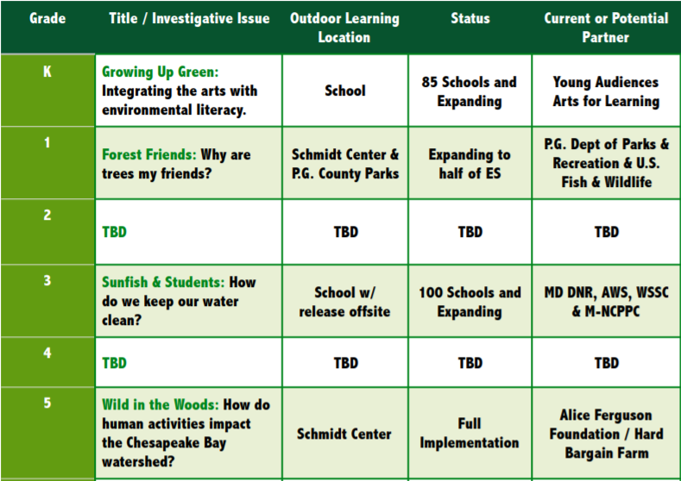
Environmental Literacy Plan
Prince George’s County Public Schools
Elementary School

Slide 13
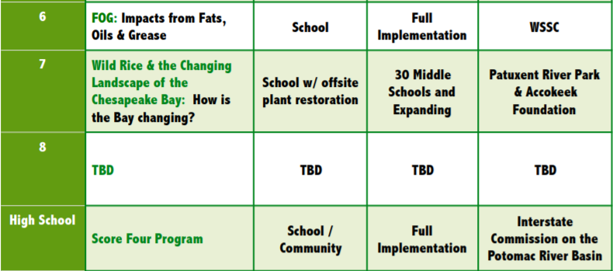
Environmental Literacy Plan
Prince George’s County Public Schools
Middle School & High School

Slide 14
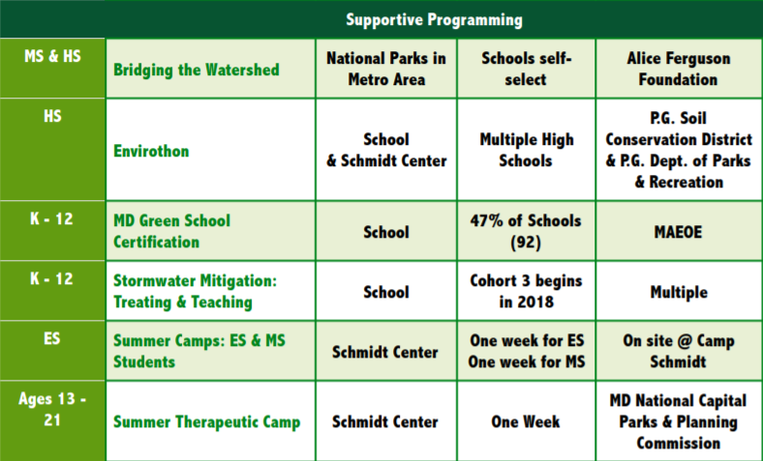
Environmental Literacy Plan
Prince George’s County Public Schools

Slide 15
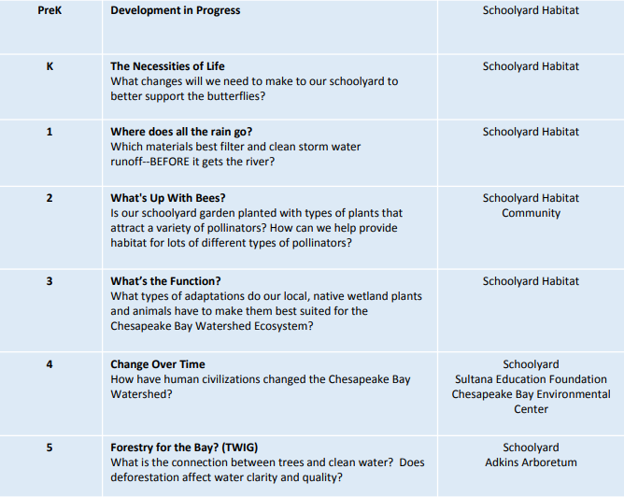
Environmental Literacy
Plan
Queen Anne’s County Public Schools
Elementary School

Slide 16
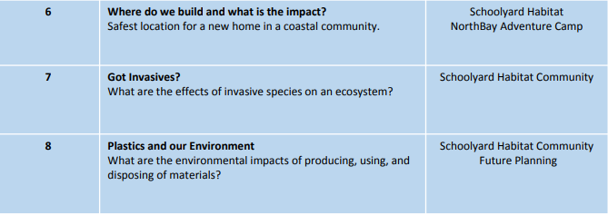
Environmental Literacy
Plan
Queen Anne’s County Public Schools
Middle School

Slide 17
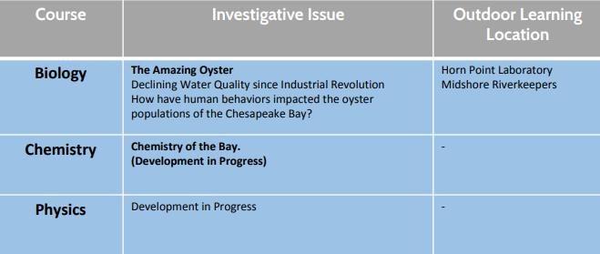
Environmental Literacy
Plan
Queen Anne’s County Public Schools
High School

Slide 18
How do you see a district or county-wide Environmental Literacy Plan helping the implementation and continuation of a MWEE?

