Slide 1
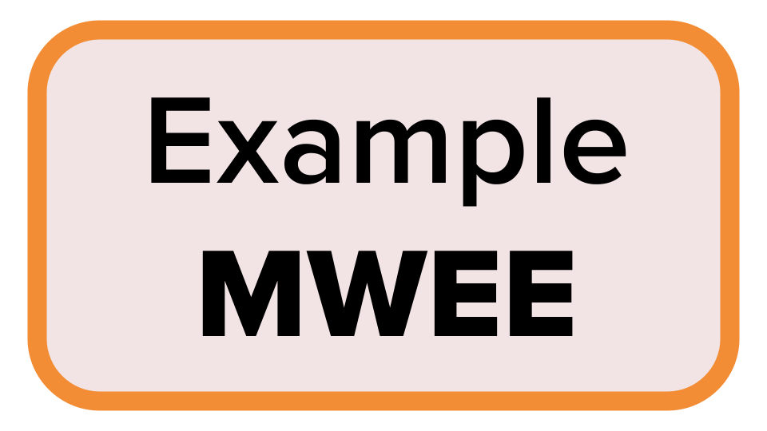
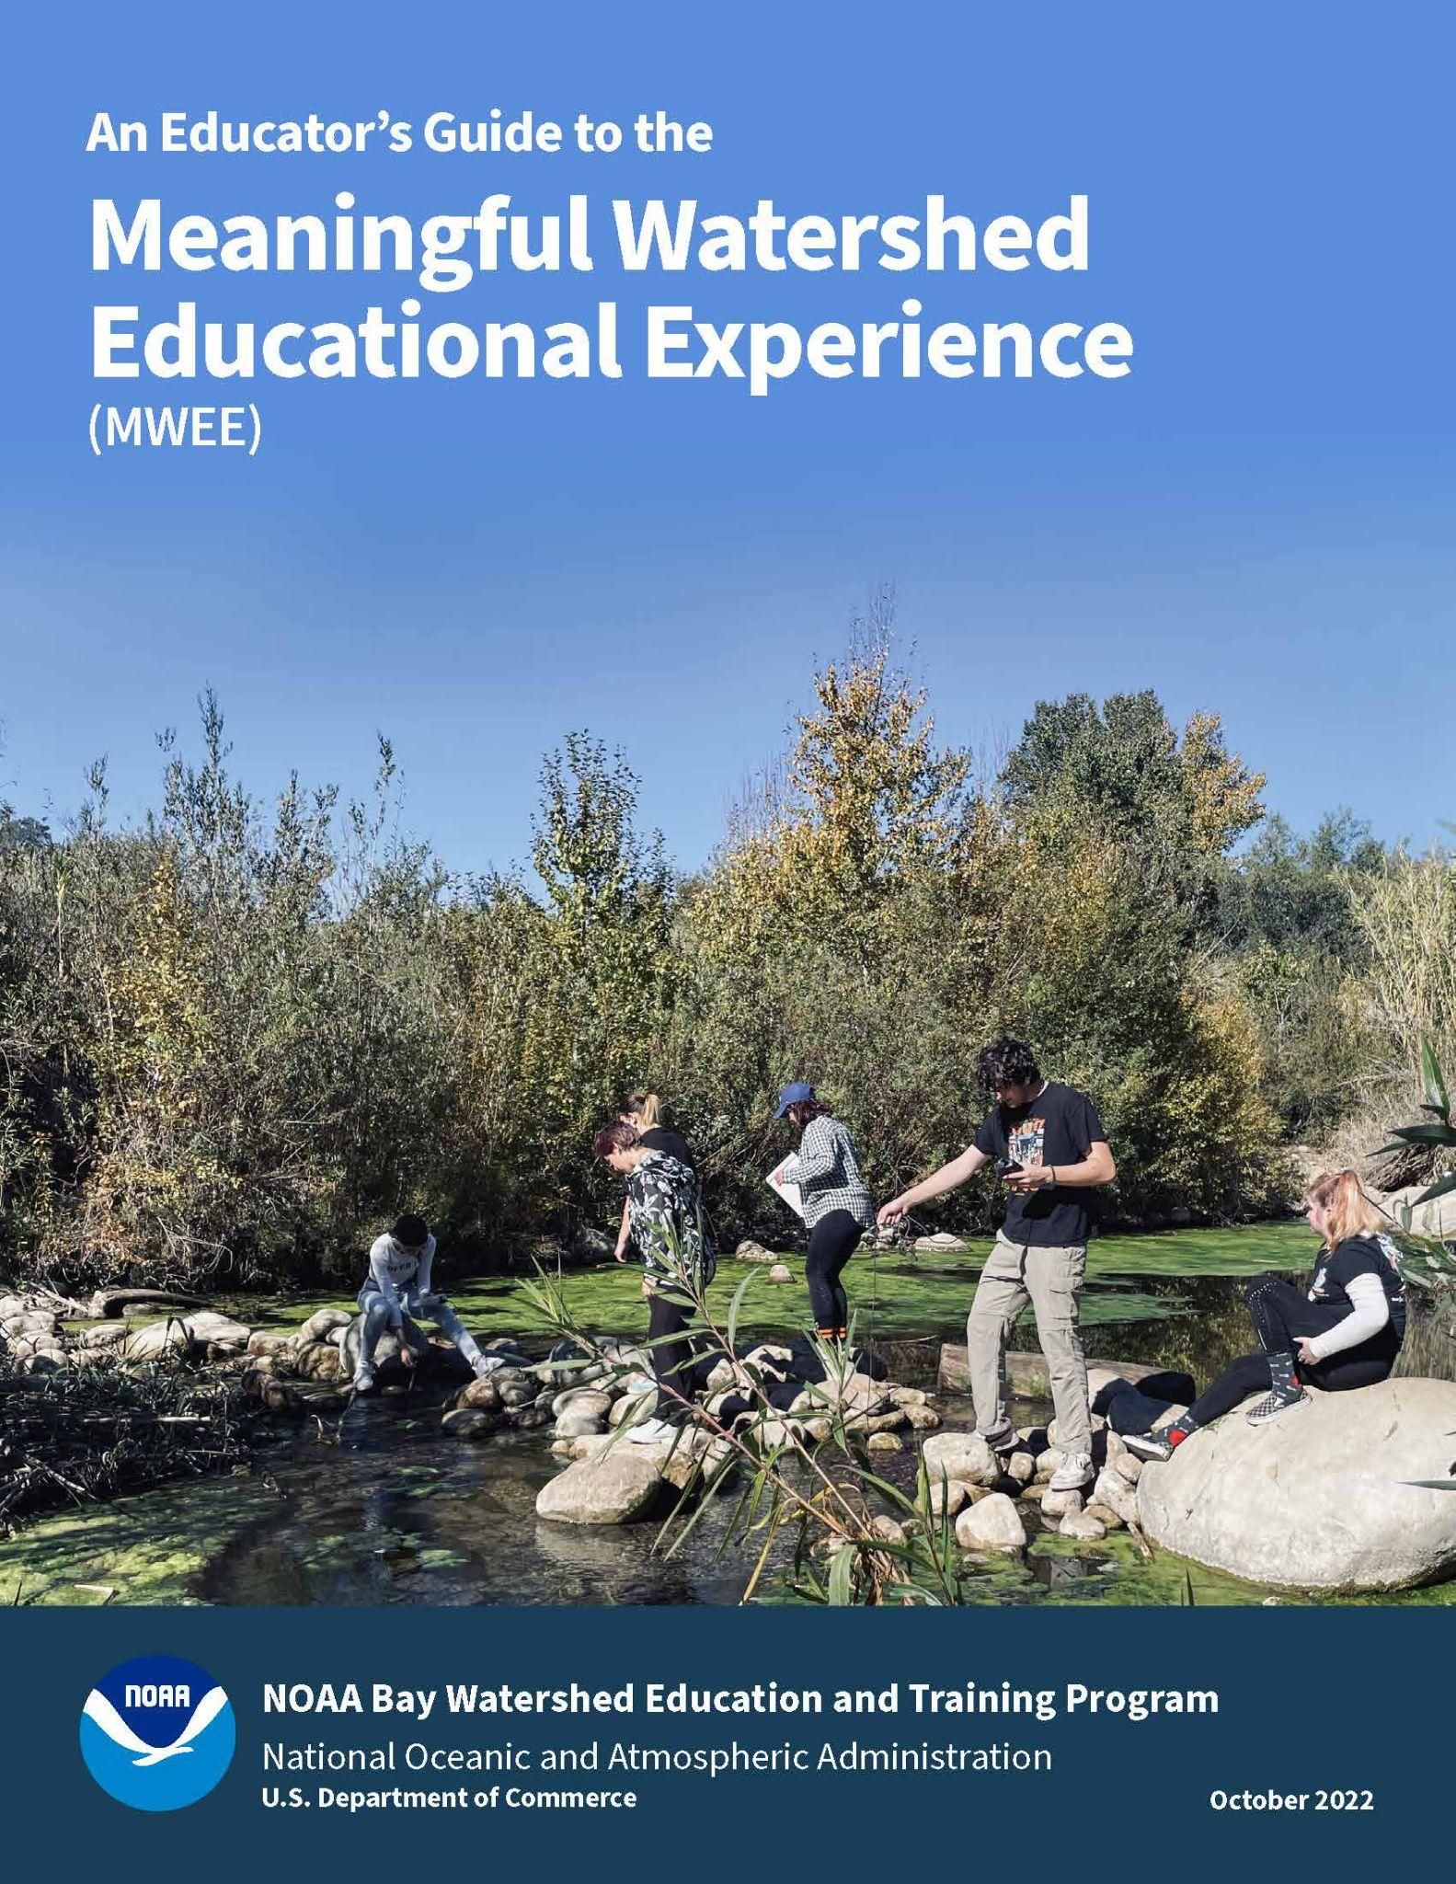
Engagement Questions when participants have on their “educator-hat”.
Referencing text and worksheets in “An Educator’s Guide to the Meaningful Watershed Educational Experience” Guide (October 2025 update).
Review an example MWEE from ShoreRivers.
Participants working on their own MWEE.
Student Worksheets from the MWEE Toolbox
Work on your workshop’s modeled MWEE. You will develop the Driving Question and the participants will work together to develop the supporting questions and take it through to the action project.

